Slide 1
2020 STARTED OUT WITH A BANG

Slide 3
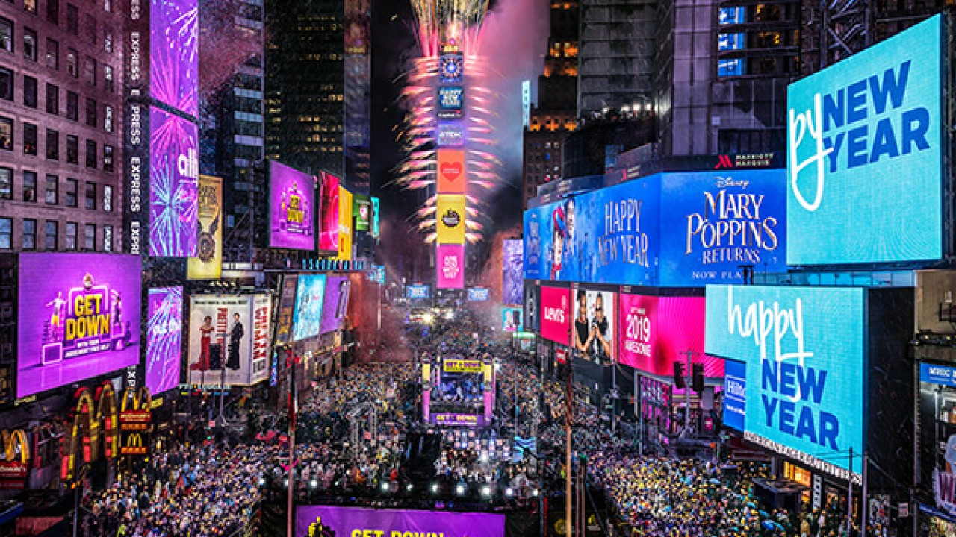

Slide 4
WE WELCOMED NEW FRIENDS TO OUR NEW OFFICE

Slide 7
WE WELCOMED OLD FRIENDS TO OUR NEW OFFICE

Slide 10
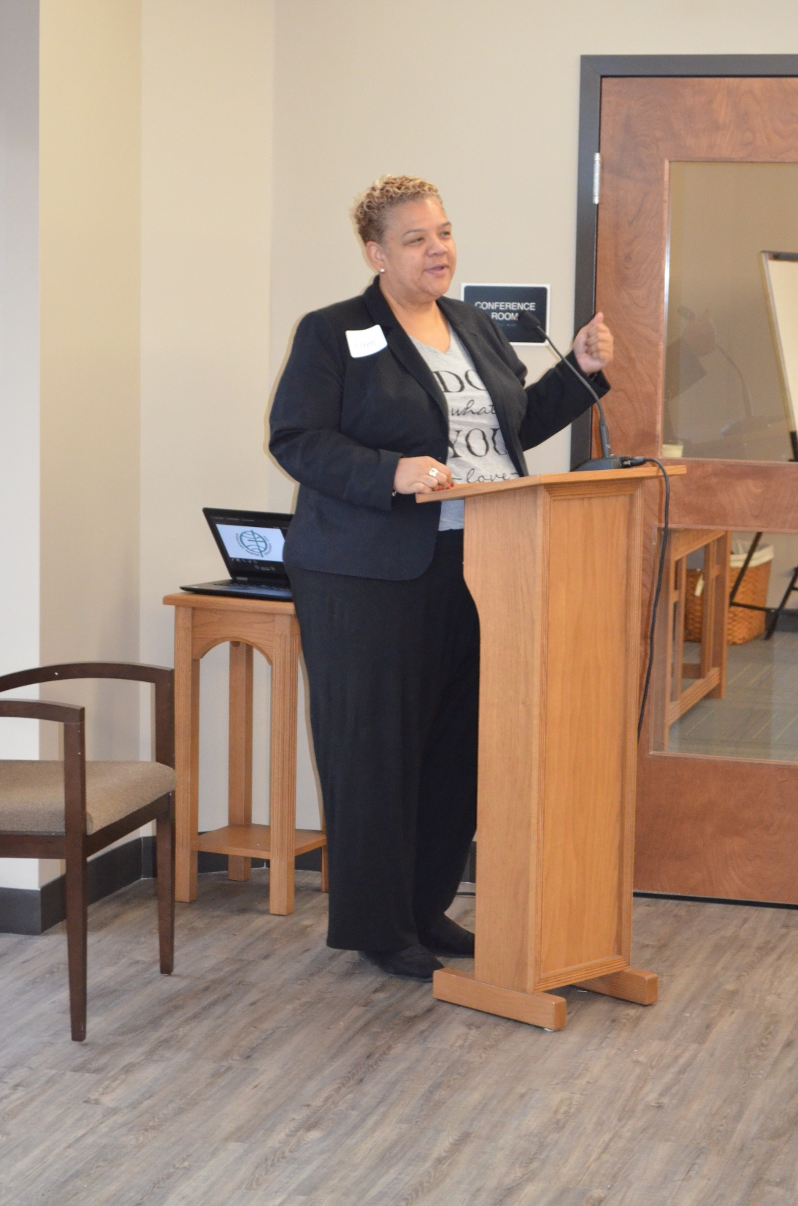

Slide 14
AND THEN… MARCH 13, 2020

Slide 15
President Trump declares coronavirus outbreak a national emergency

Slide 16
AND EVERYDAY LIFE BEGAN TO LOOK A LITTLE DIFFERENT

Slide 17
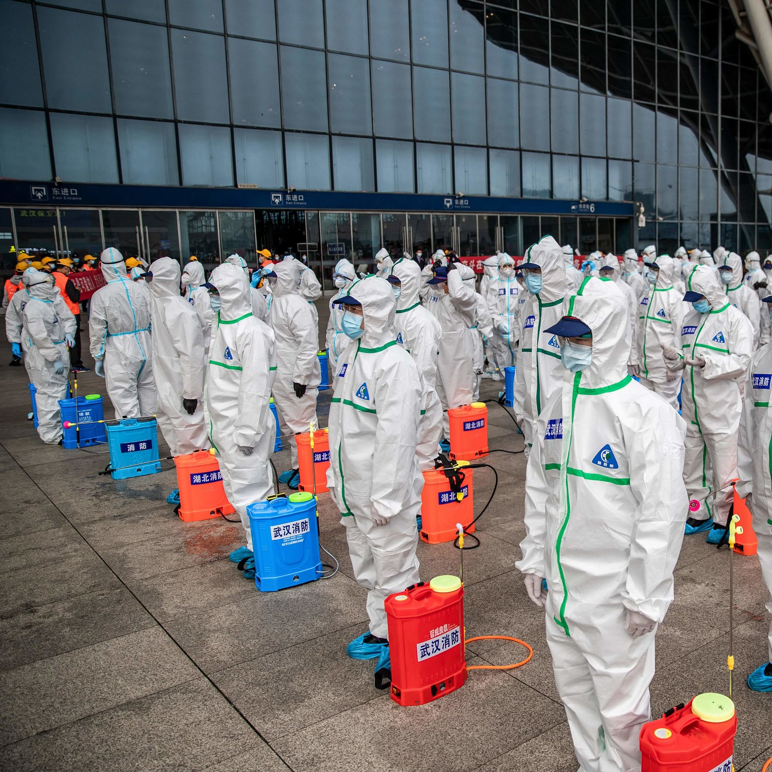

Slide 18
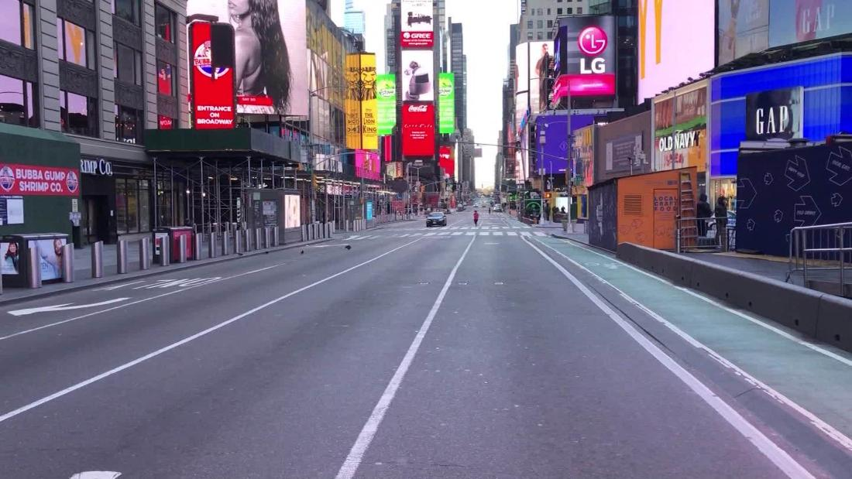

Slide 20
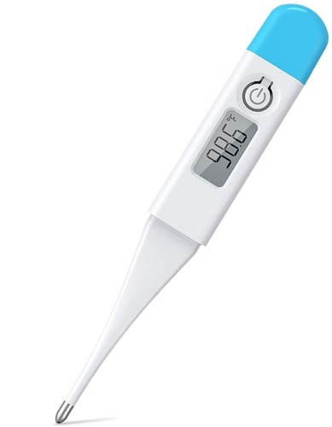

Slide 21
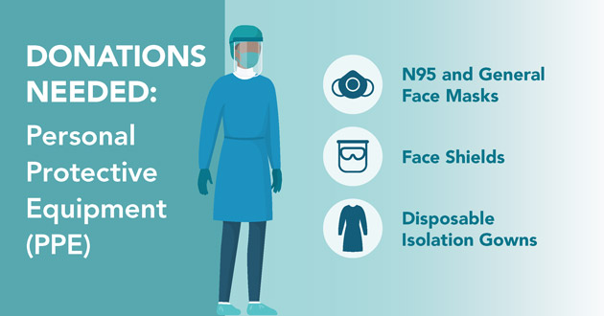

Slide 22
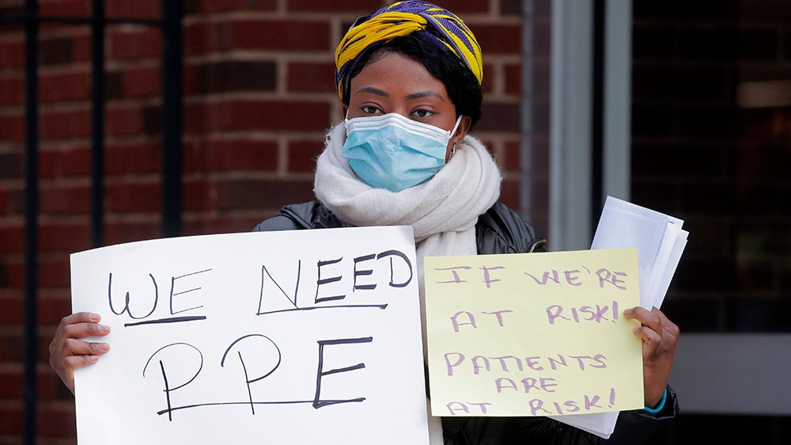

Slide 24
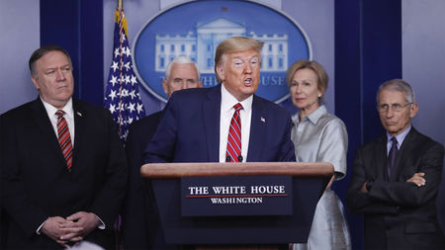

Slide 25
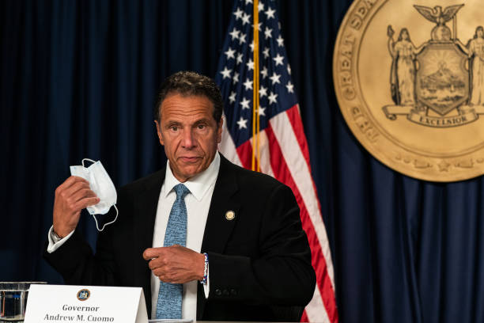

Slide 26
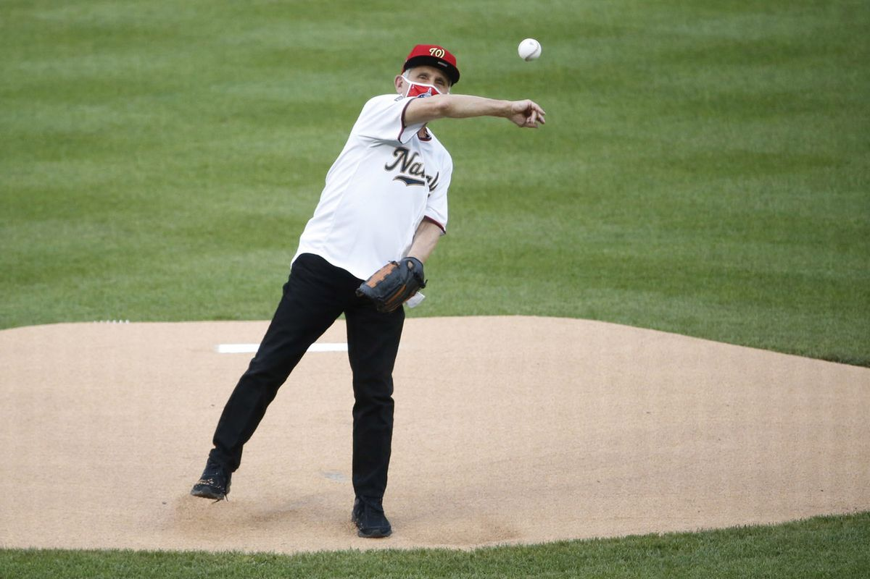

Slide 28
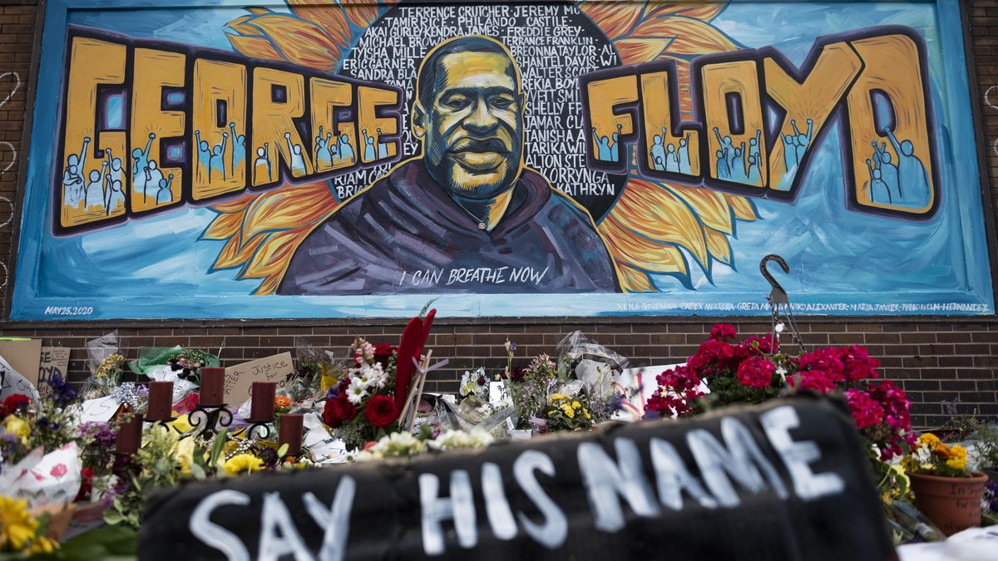

Slide 29
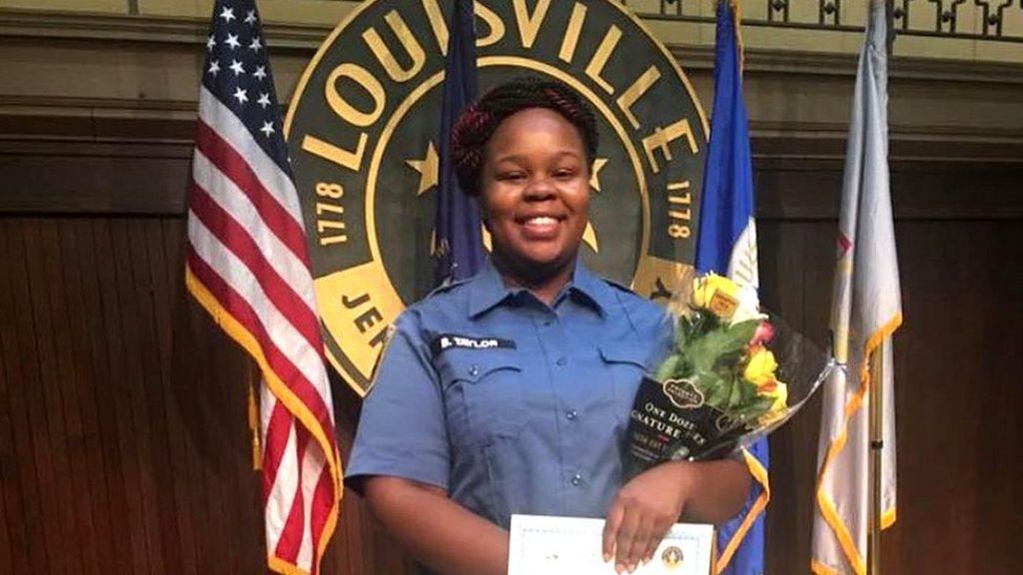

Slide 30
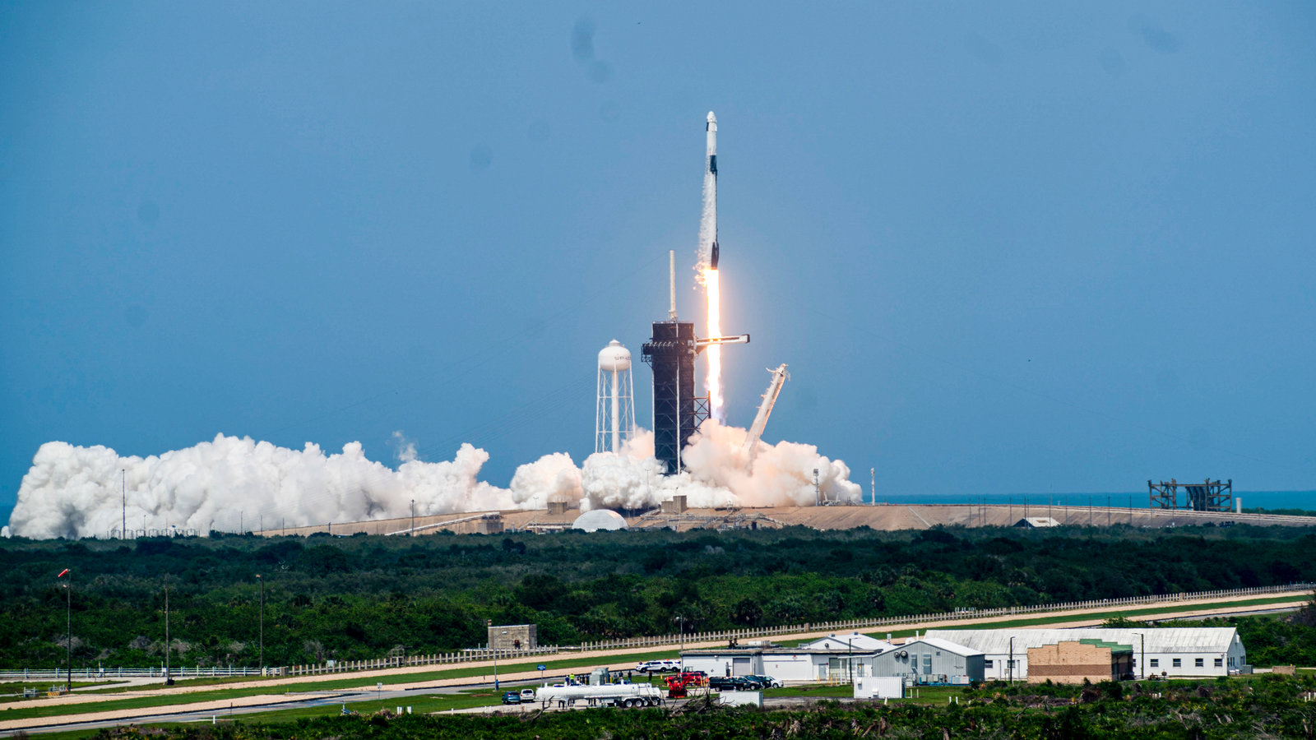

Slide 31
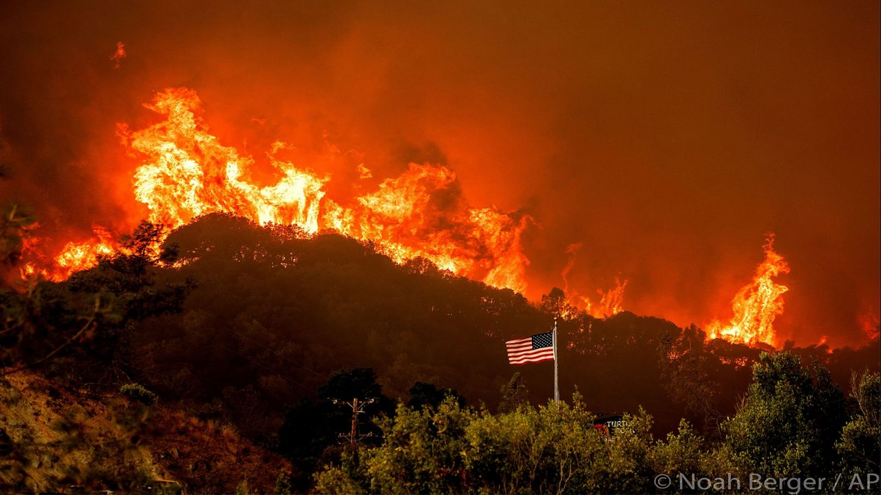

Slide 33
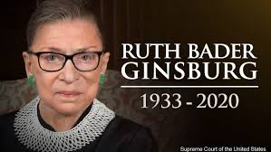

Slide 34
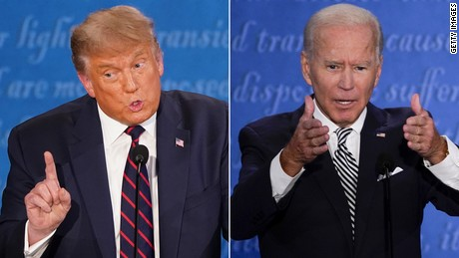

Slide 35
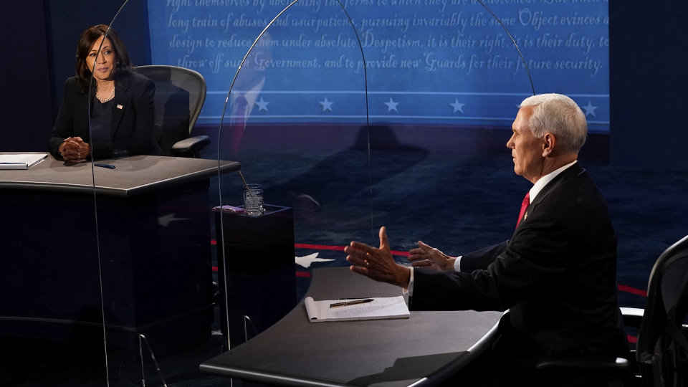

Slide 36
WE LEARNED TO ADAPT AND THE MINISTRY OF ABCUSA PUSHED FORWARD

Slide 38
American Baptist Churches USA Survey Assesses Impact of COVID-19

Slide 39
ABC Creation Justice Network Webinar Series, “Praying with Creation”

Slide 40
ABCUSA Generosity Project

Slide 41
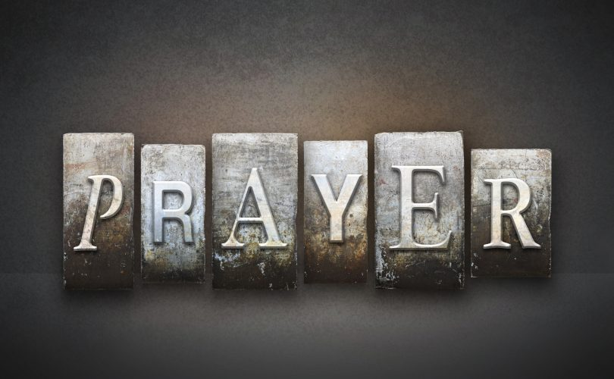
Anti-Racism Task Force Formation

Slide 42
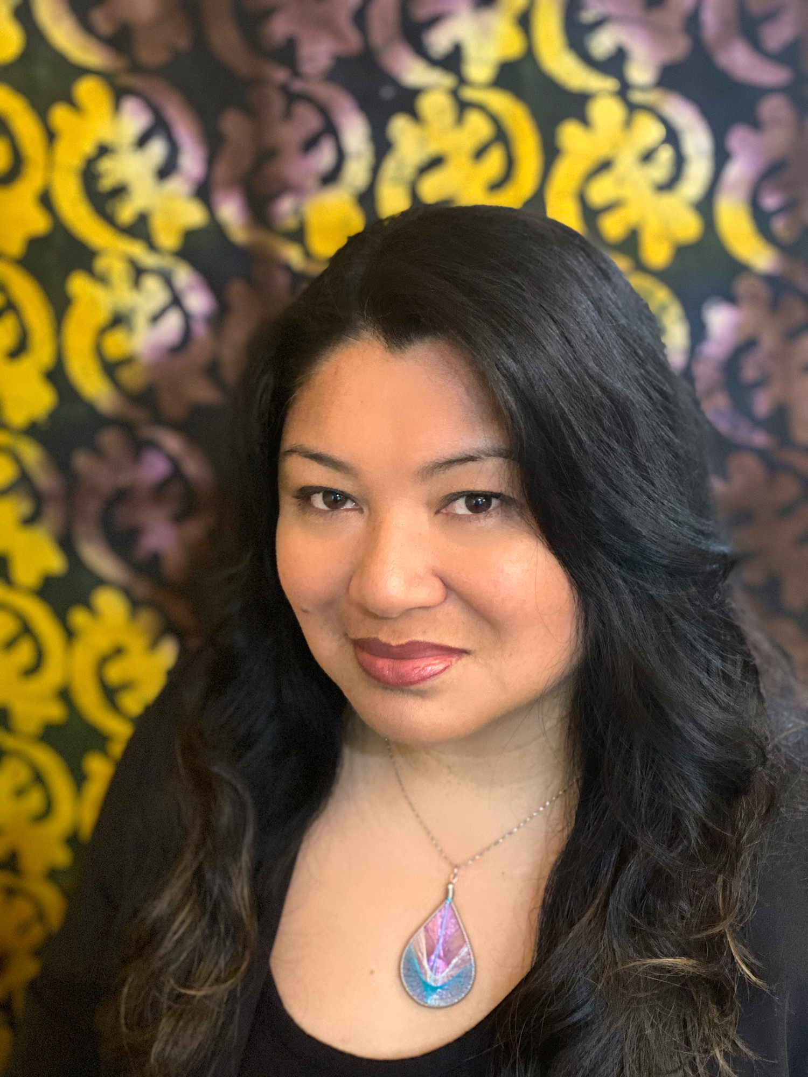
Marie Onwubuariri called as Associate General Secretary for Mission Resource Development

Slide 43
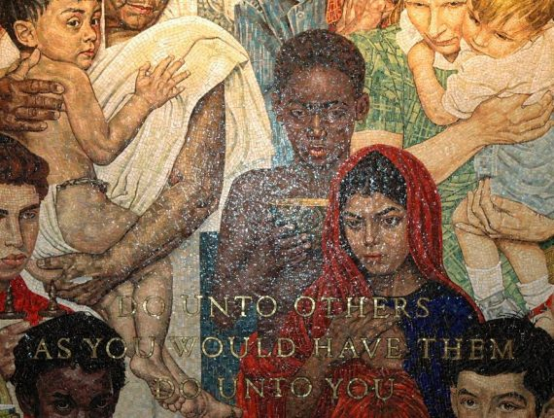
Golden Rule 2020: A Call for Dignity and Respect

Slide 44
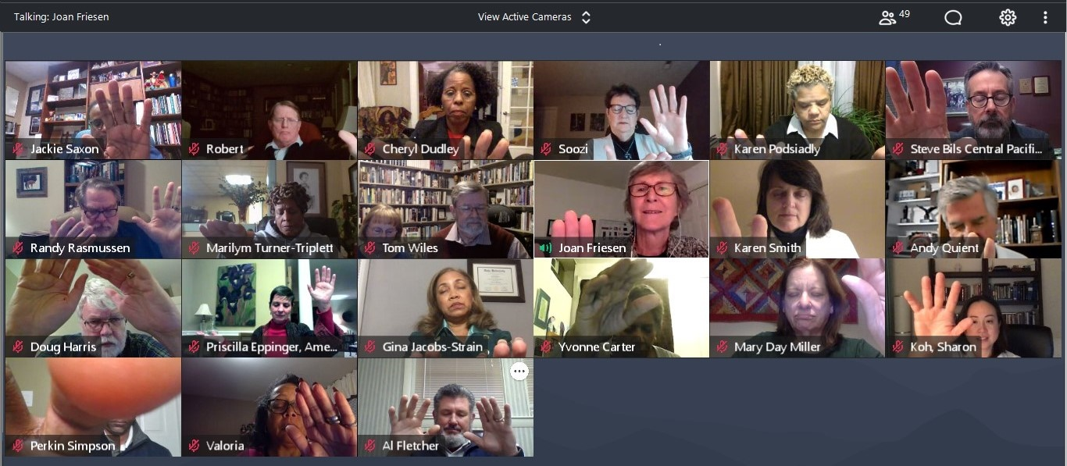
NLC RETIRING EXECUTIVES EVENT

Slide 47
June 15-18, 2022

Slide 48
AND THROUGH IT ALL… WE PERSEVERED

Slide 49
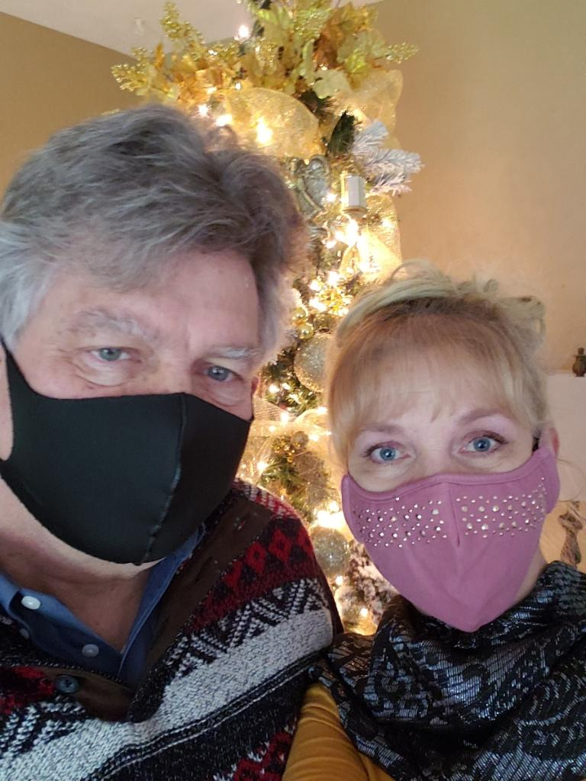
Jeff and Kandy

Slide 50
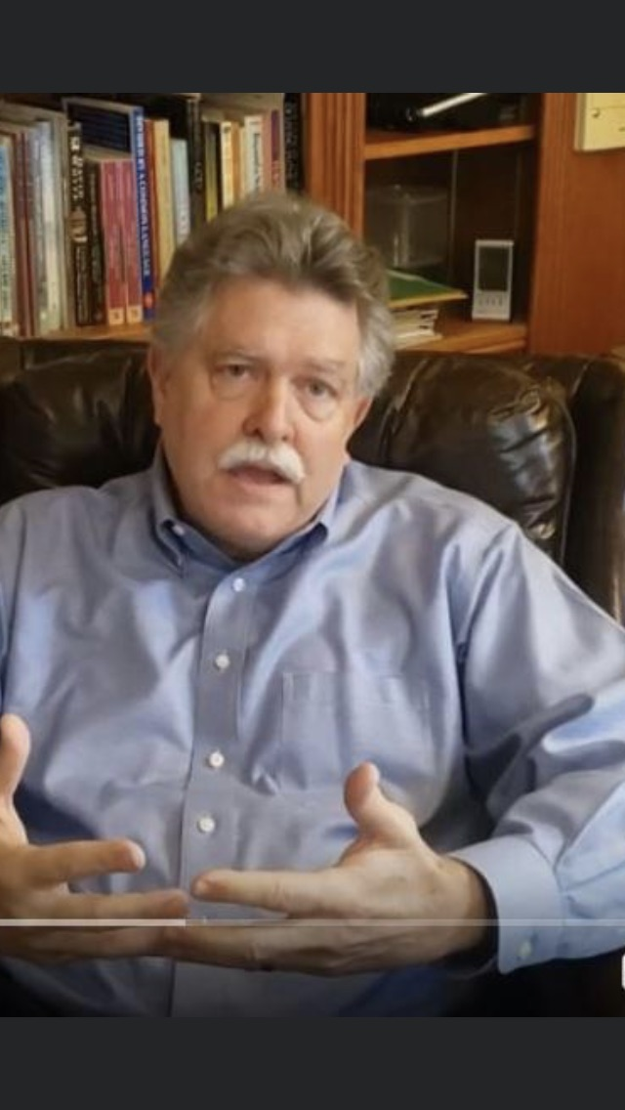

Slide 51
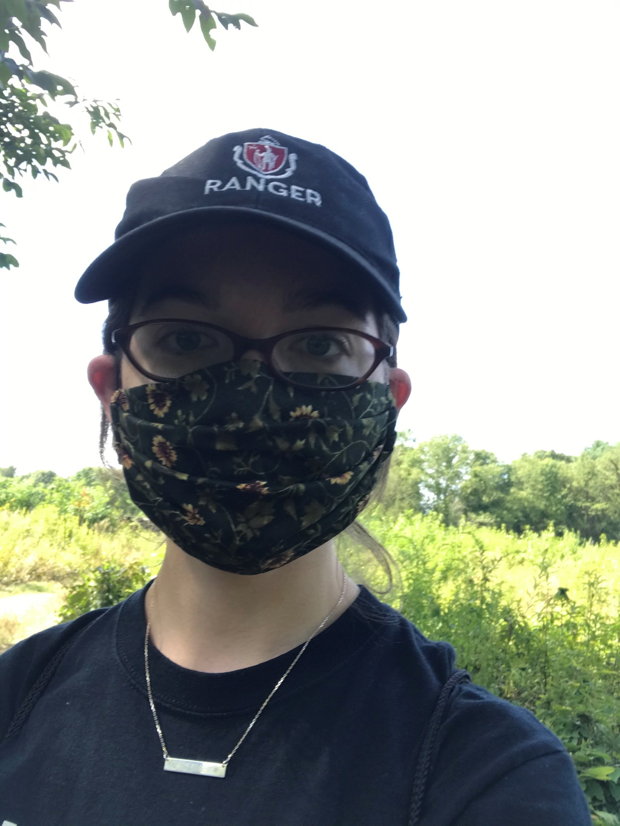
Rebecca

Slide 52
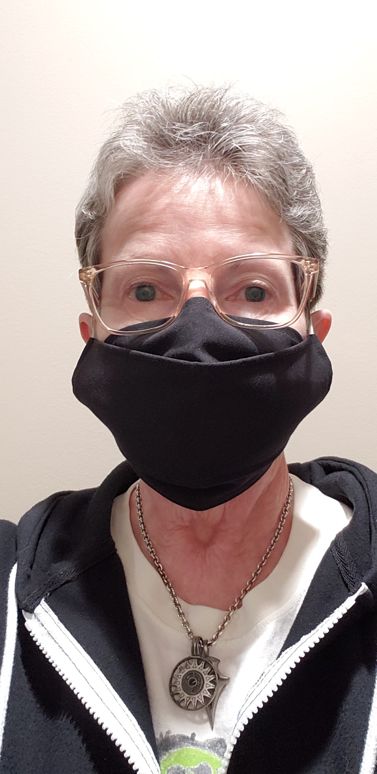
Geri

Slide 53
Geri’s 2020 Family memories
Mother-in-Law’s Health Issues
Loss of Sister-in-Law ARLYS
Brother MARK in Nursing Home

Slide 54
Before Invisalign
After Invisalign

Slide 55
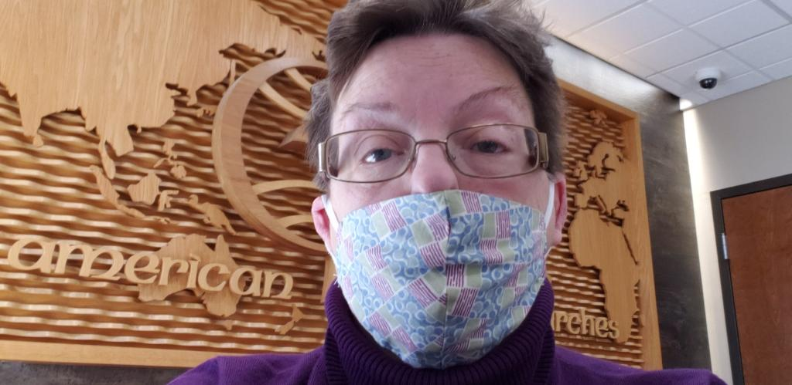
Diane

Slide 56
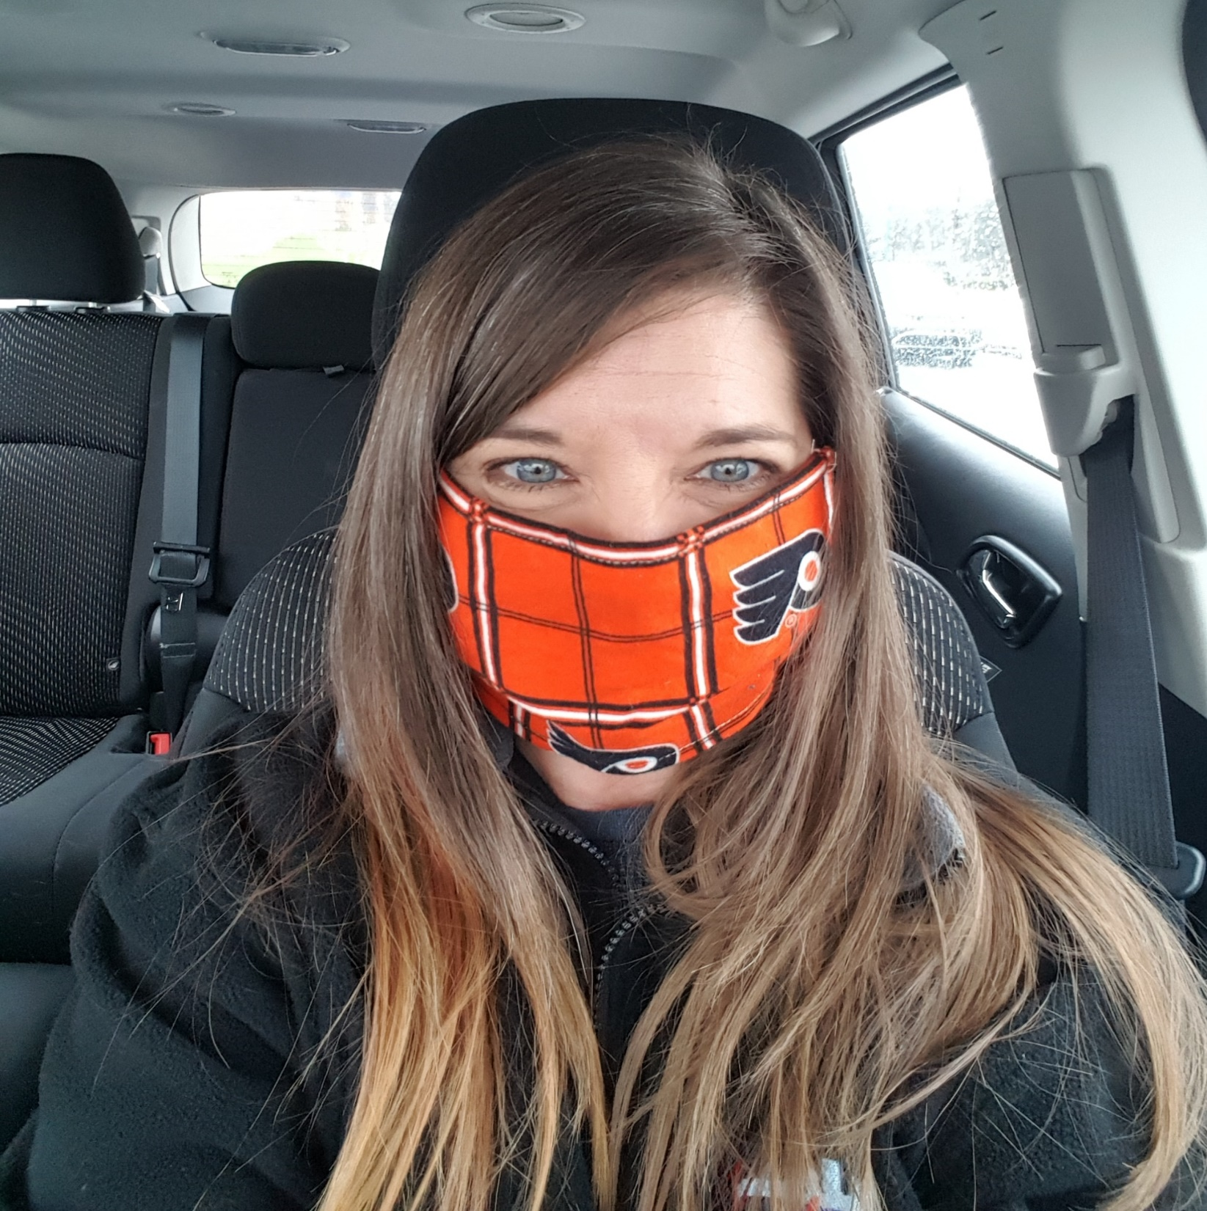
Tina

Slide 57
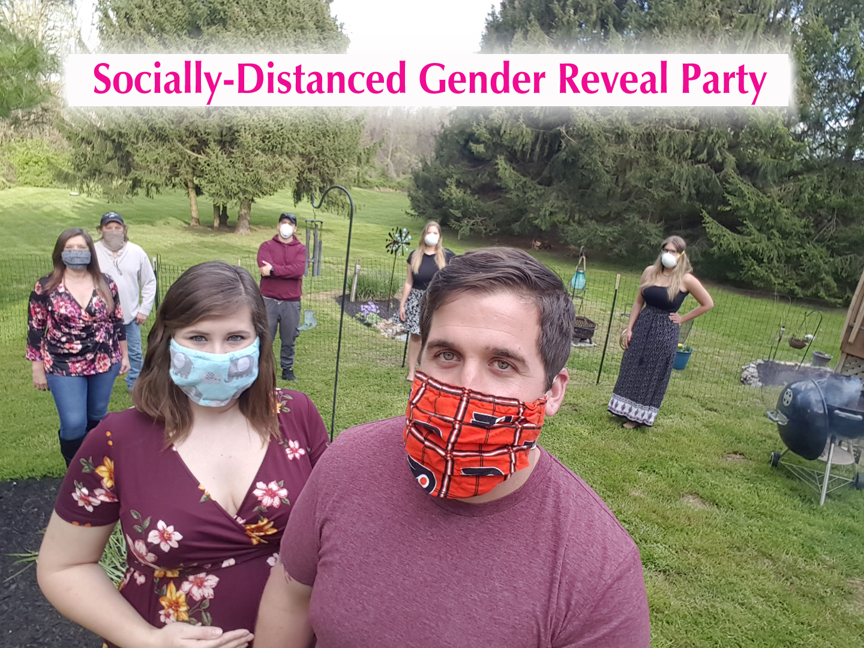
Tina Kiernan and Family

Slide 58
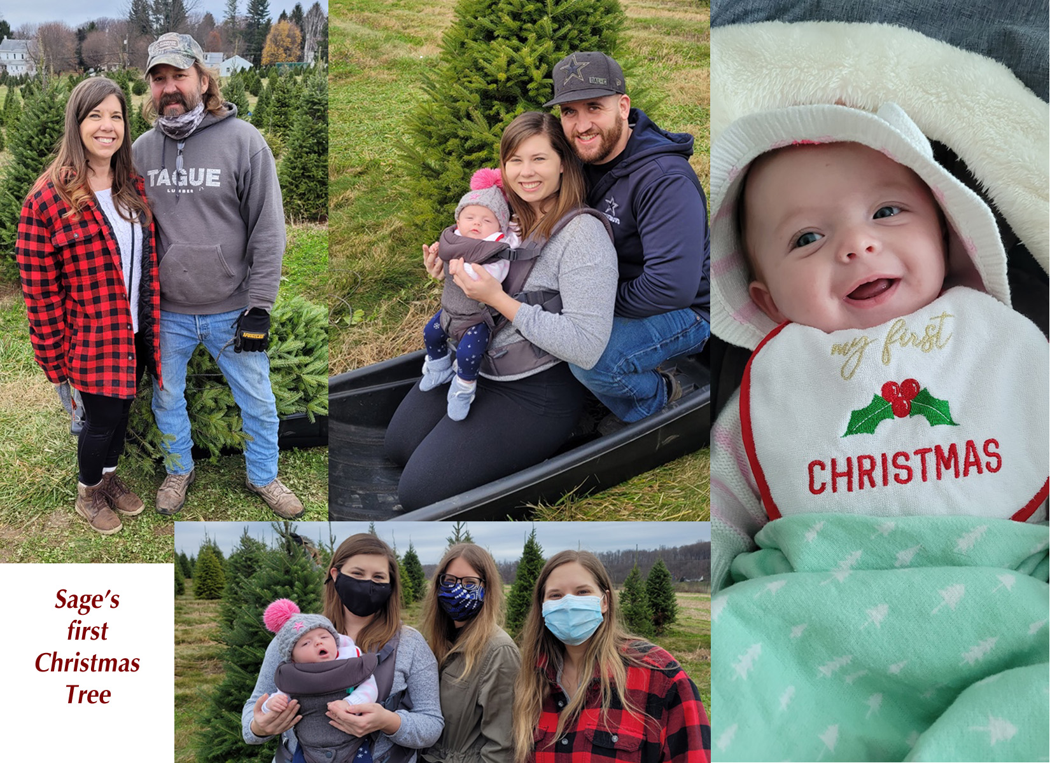

Slide 59
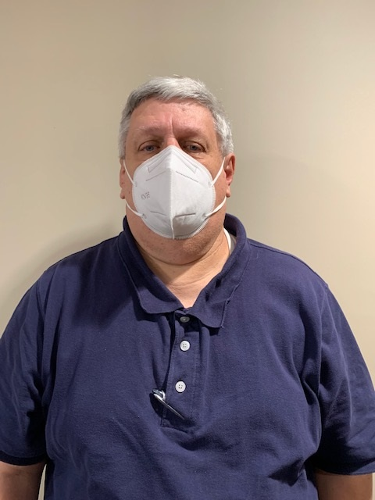
Bob

Slide 60
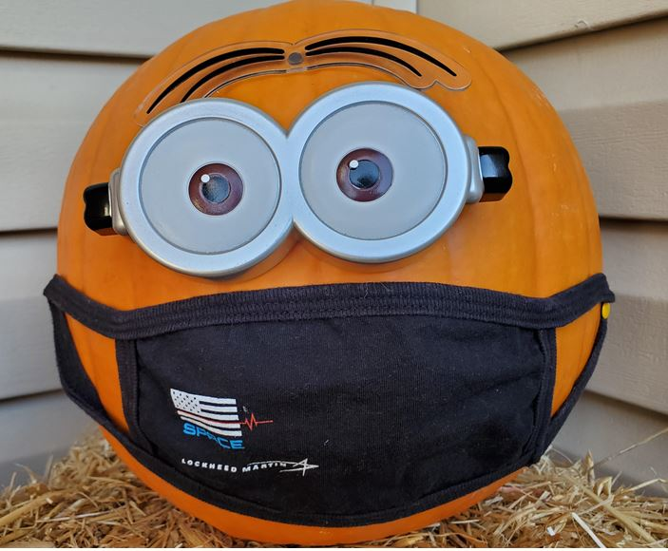
???

Slide 61
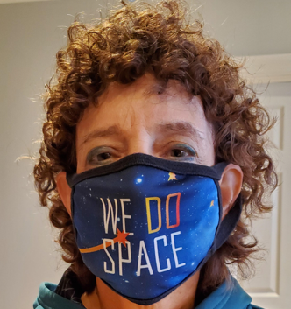
Donna

Slide 62
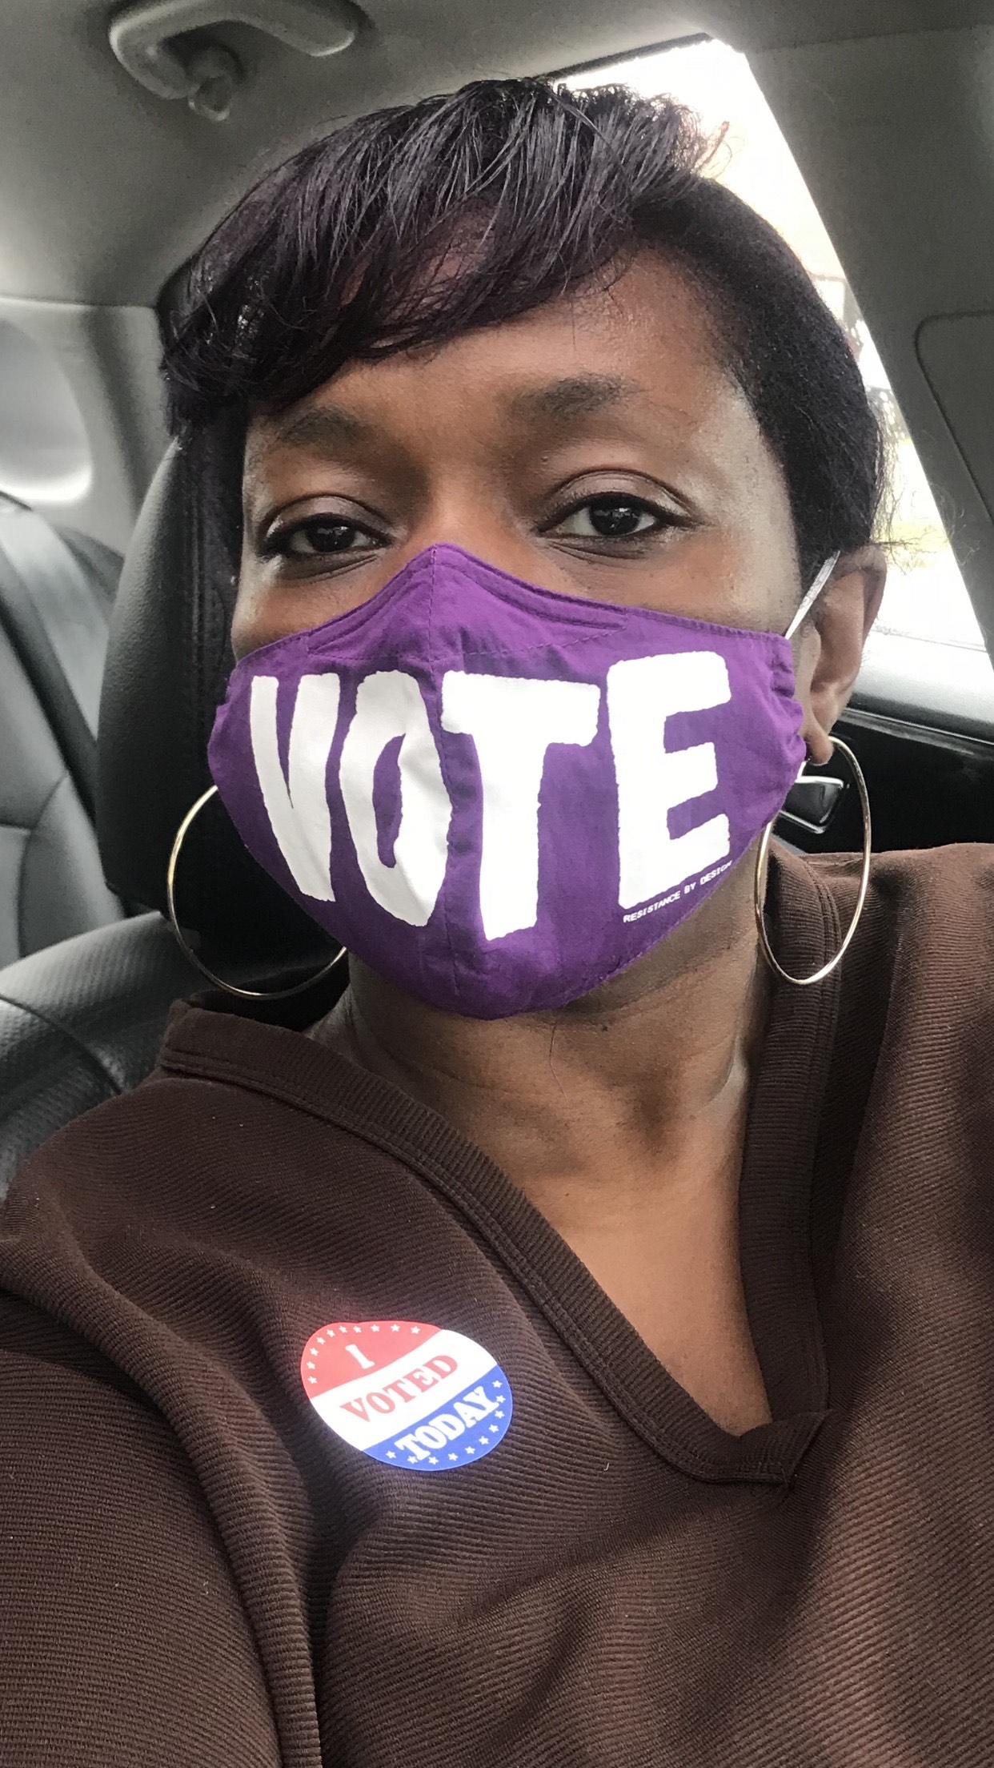
Sharese

Slide 63
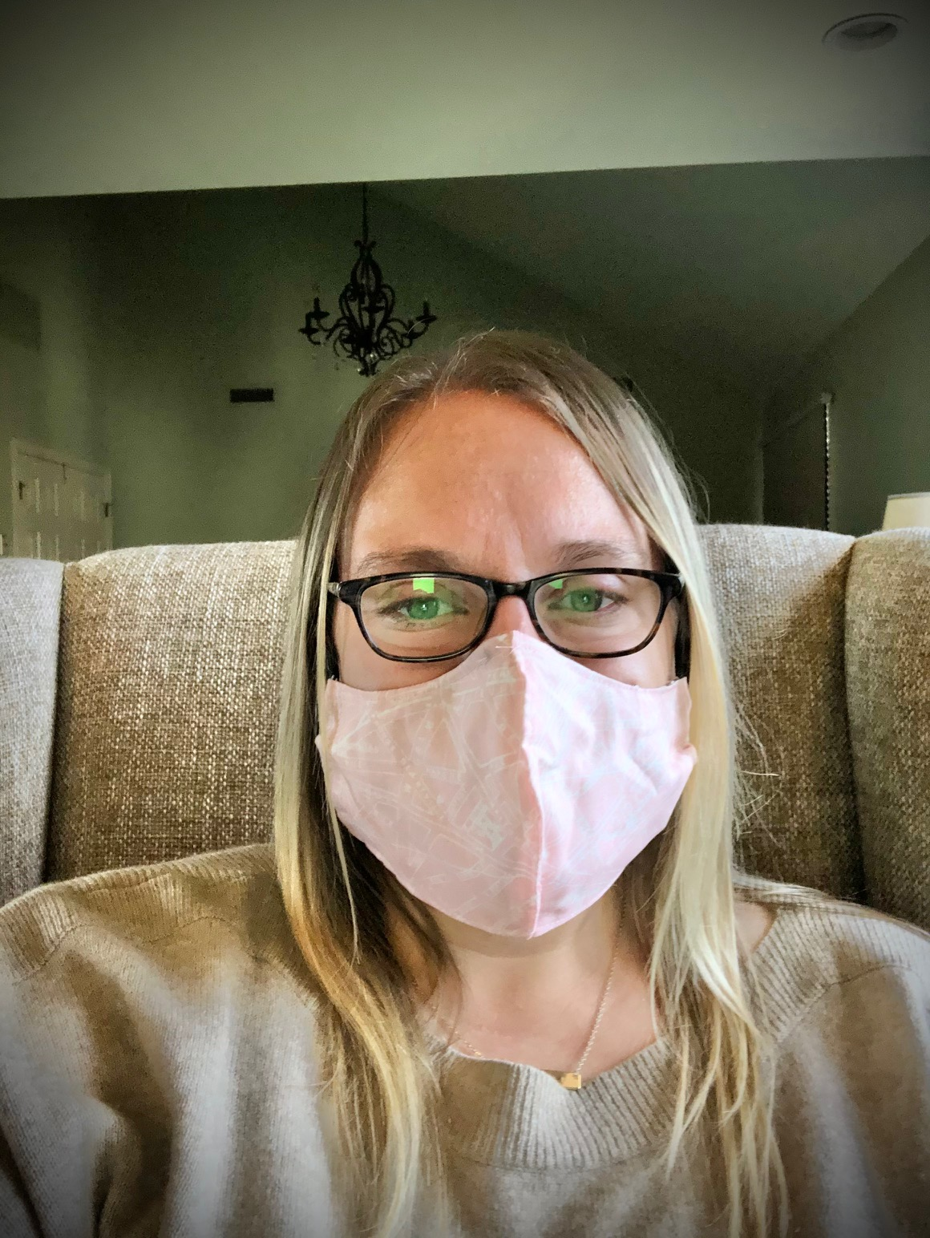
Bridget

Slide 64
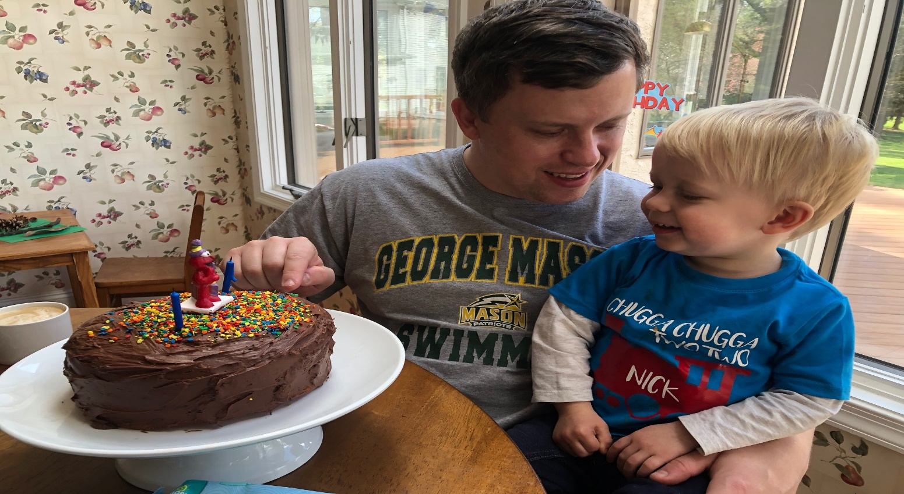
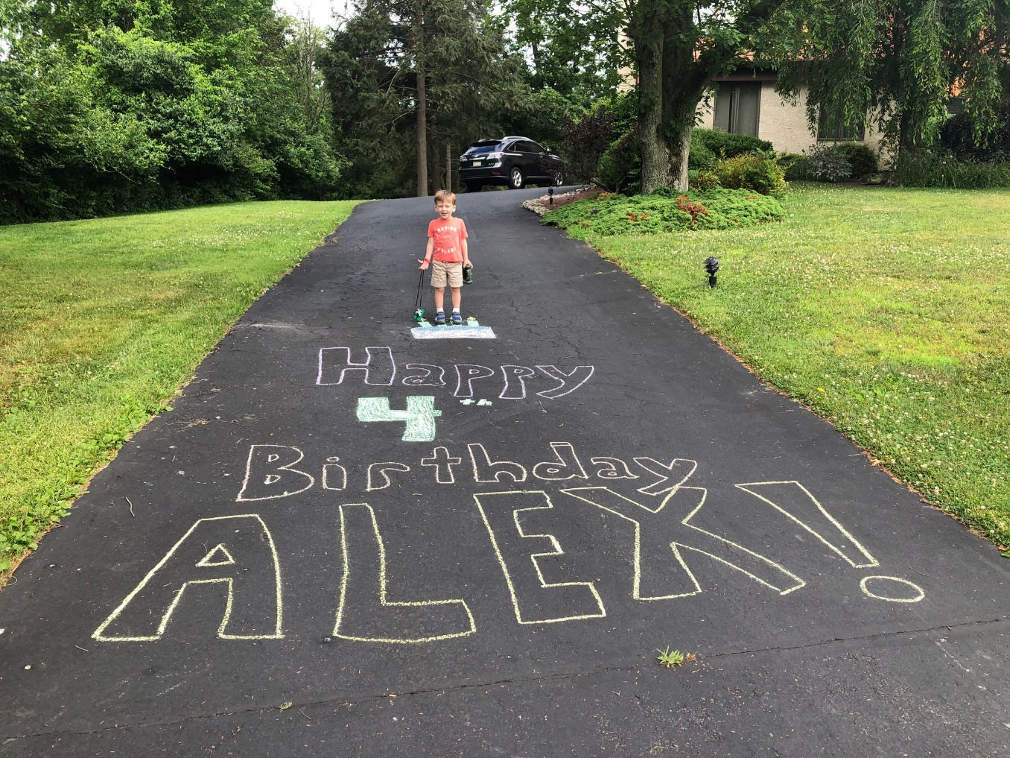
Nick (2) and
Alex (4) Lipin Celebrate Birthdays

Slide 65
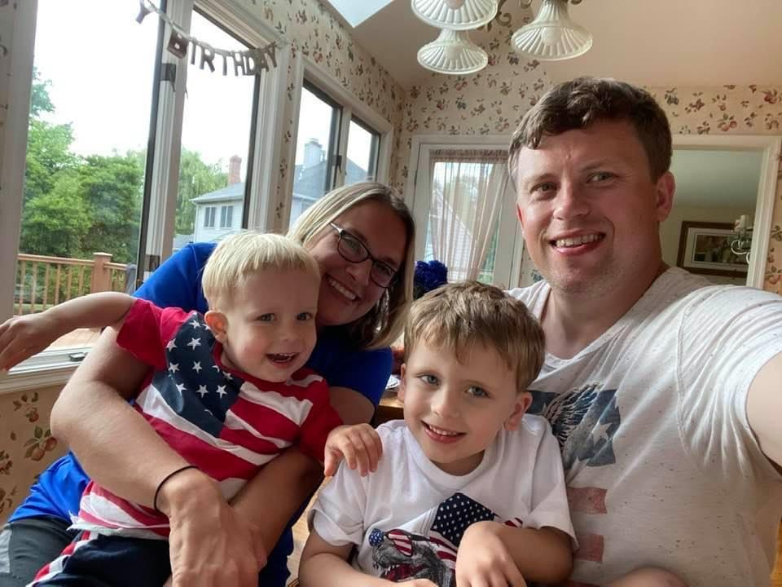
Lipin family celebrates the Fourth of July

Slide 66
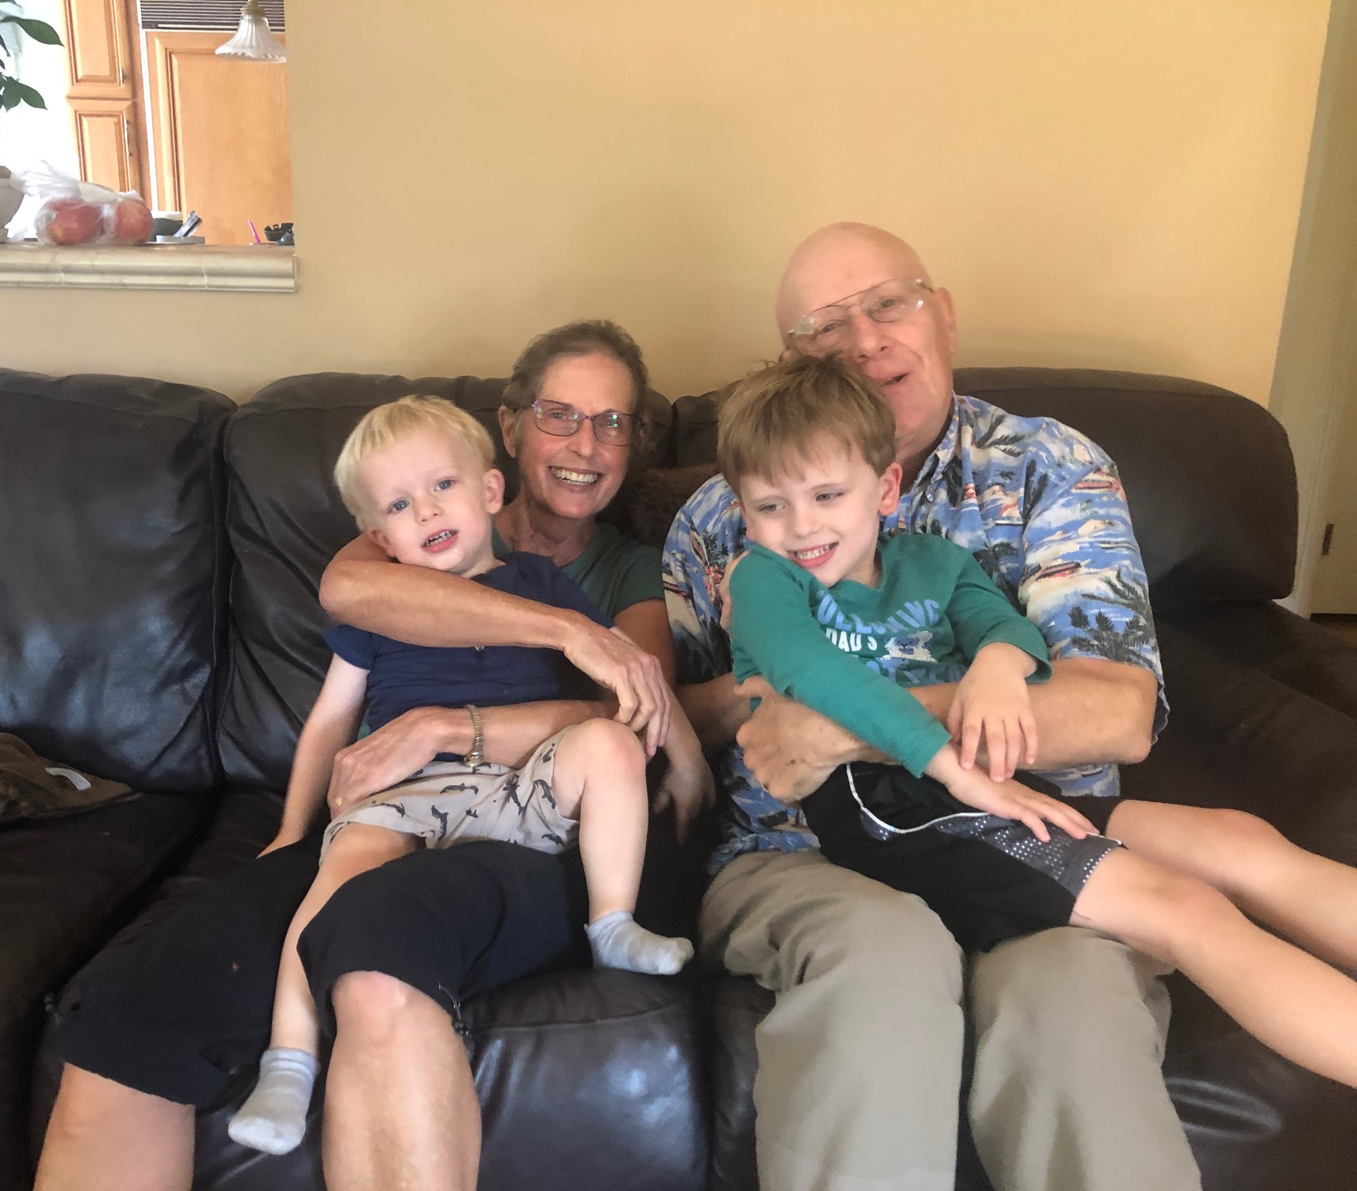
Visit with the Grandparents

Slide 67
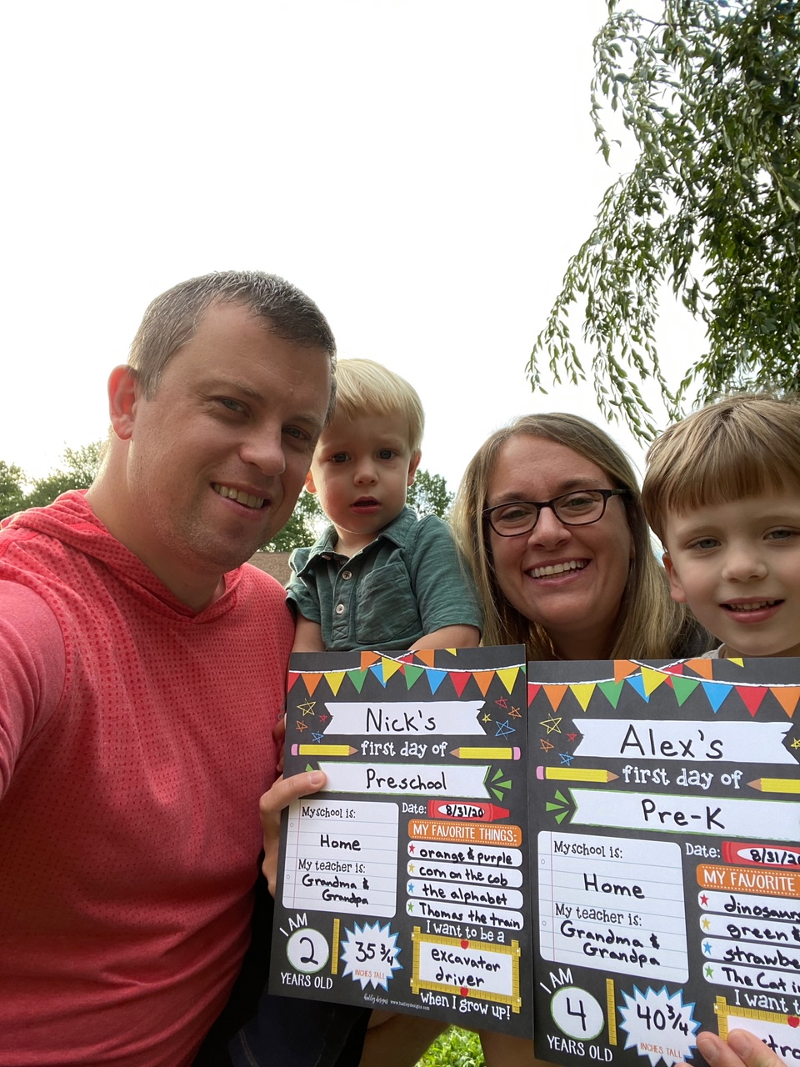
First Day of Home School

Slide 68
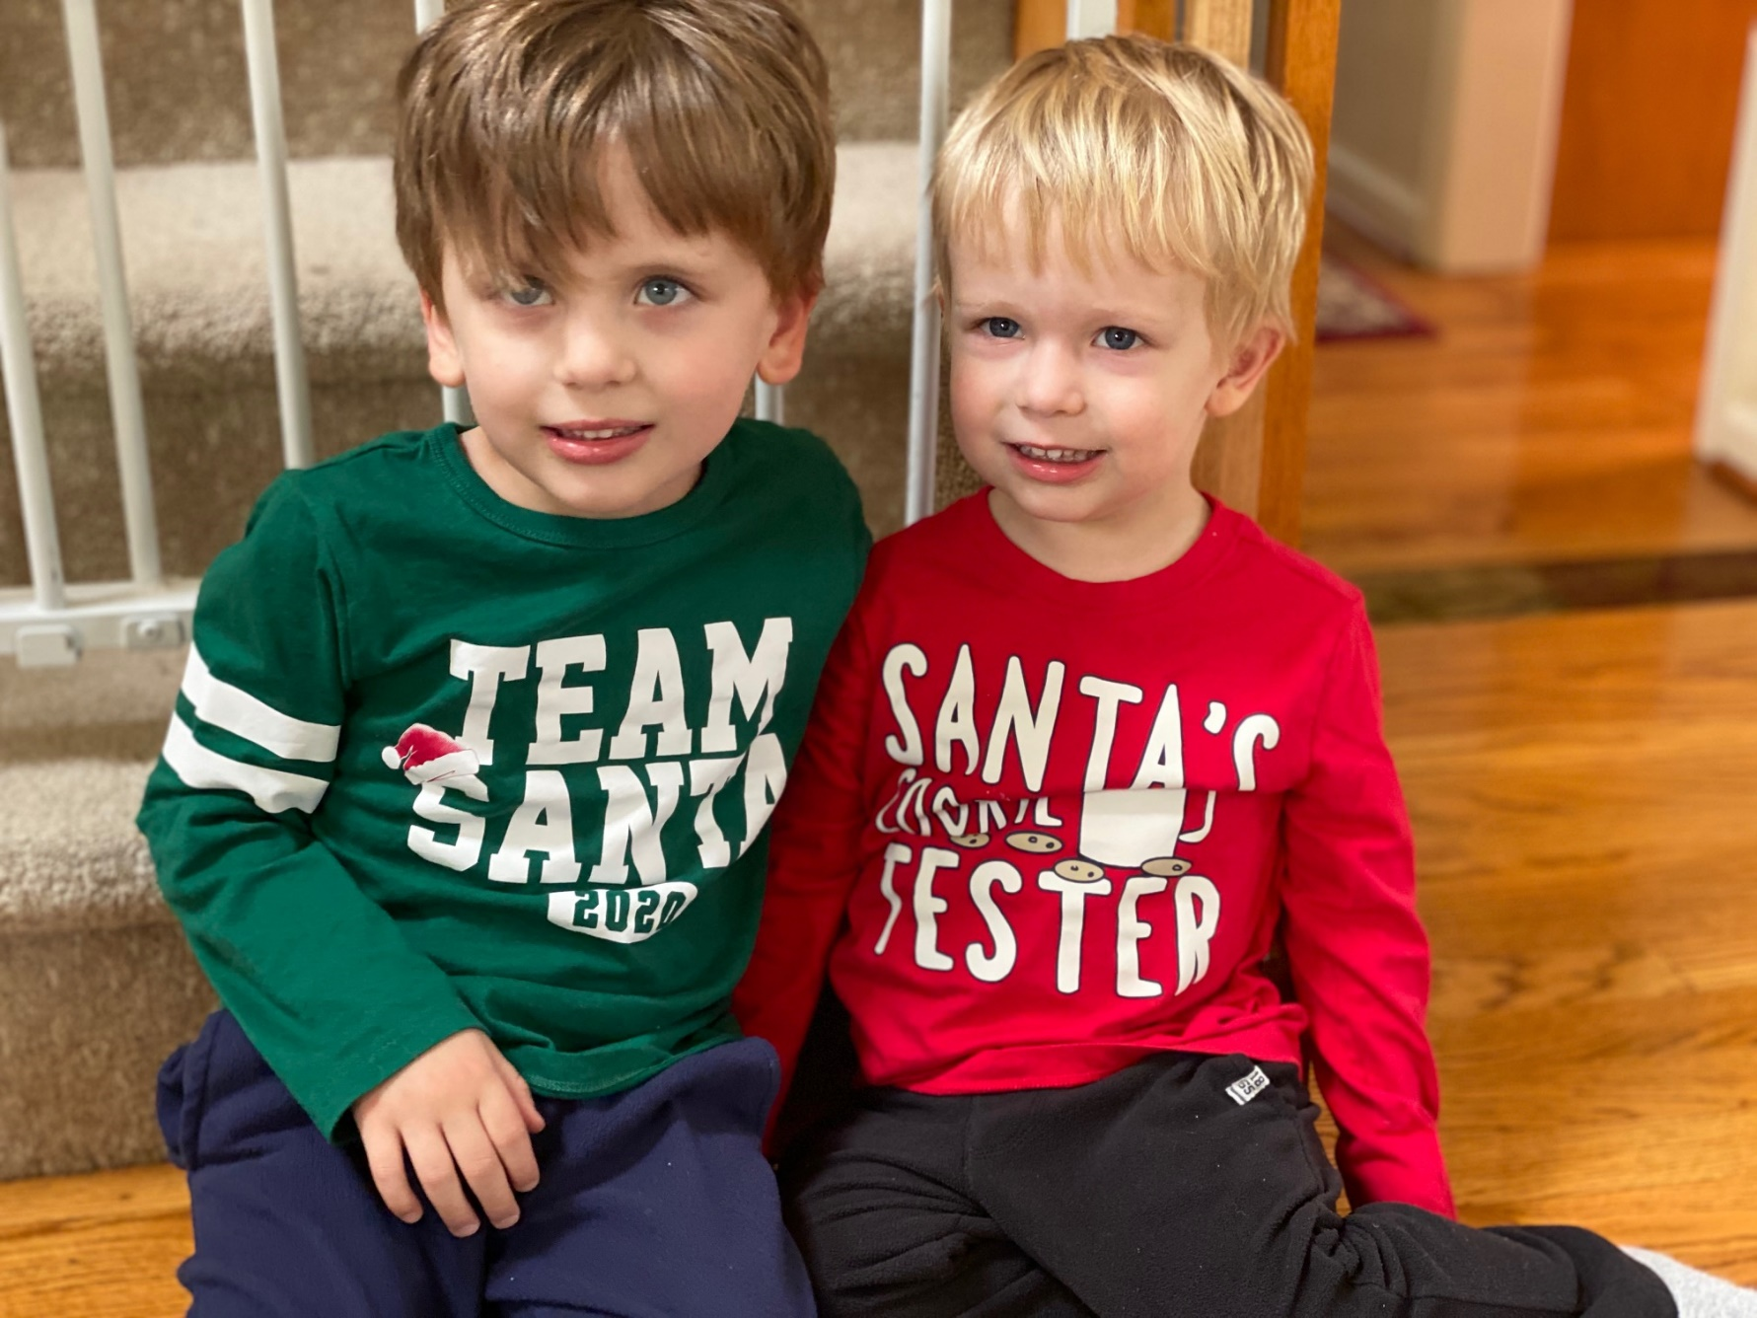
Decking the Halls!

Slide 69
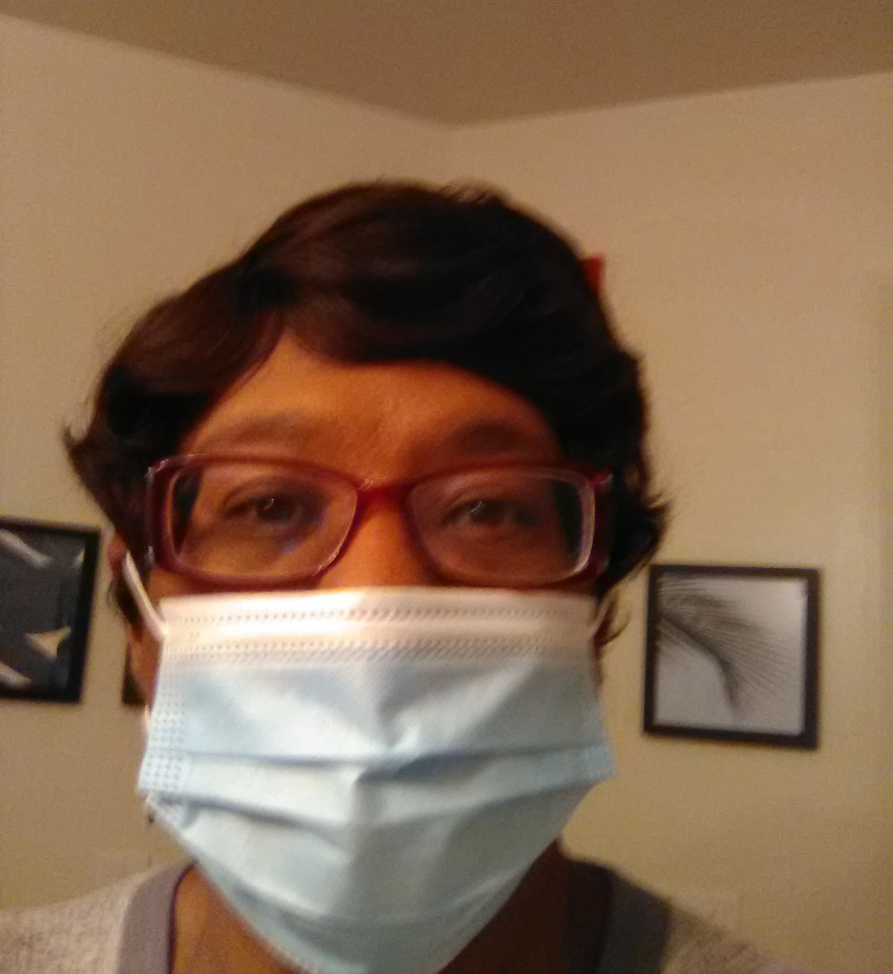
Joyce

Slide 70
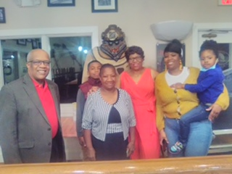
Joyce’s Birthday with Family at
Hemmingway’s Restaurant in Stevensville, MD

Slide 71
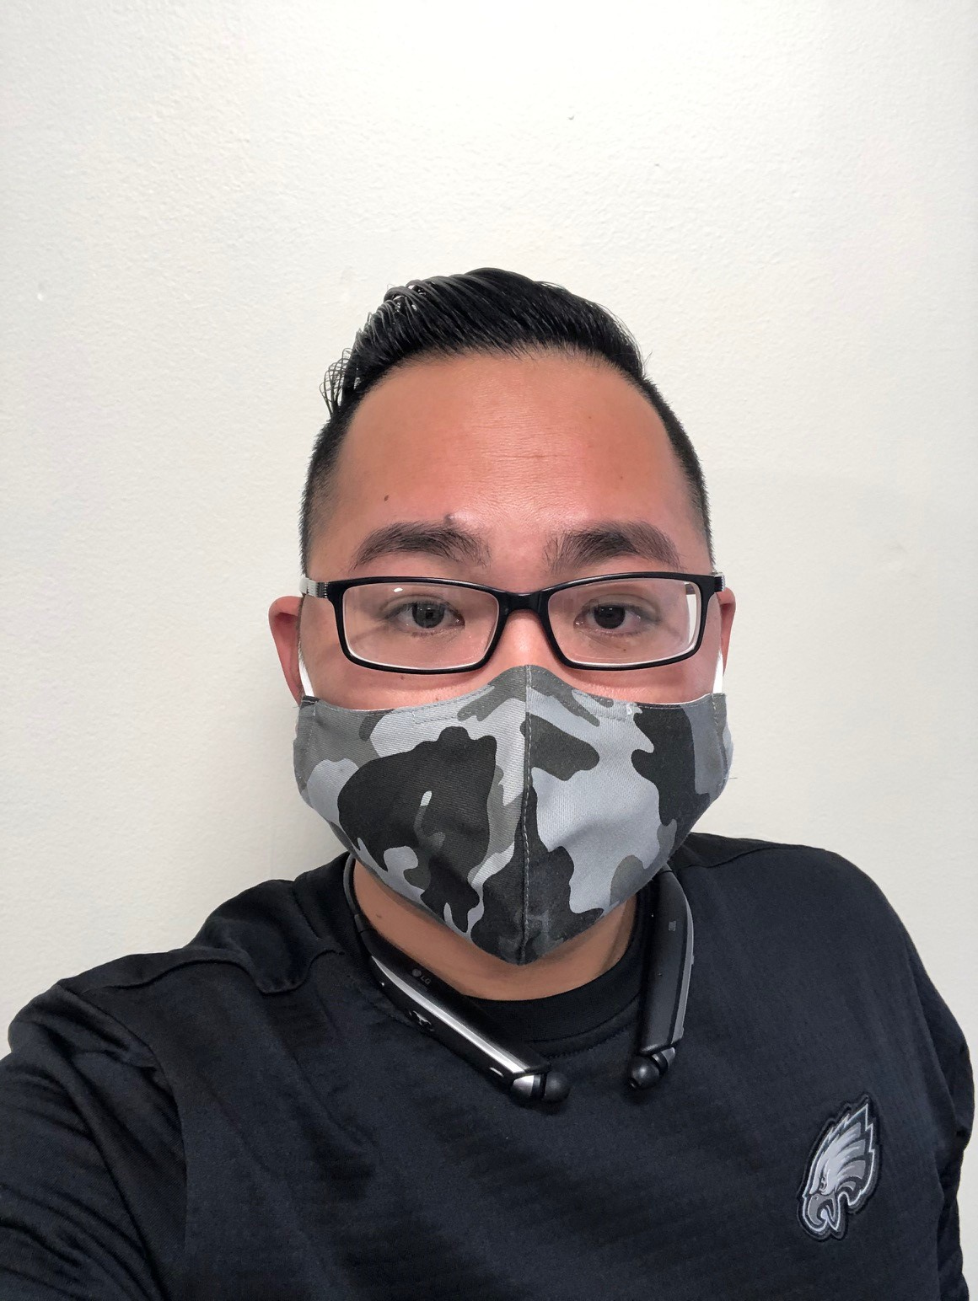
James

Slide 72
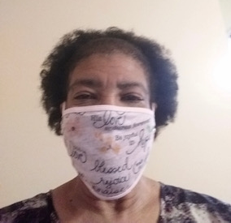
Iris

Slide 73
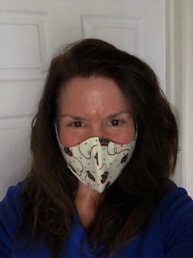
Judith

Slide 74
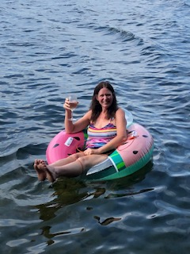
Judith enjoying some R & R

Slide 75
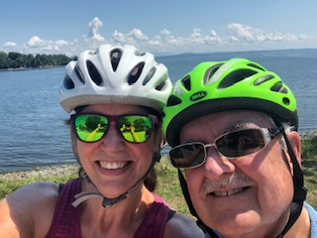
Judith and Dennis Christiansen vacationing in Vermont

Slide 76
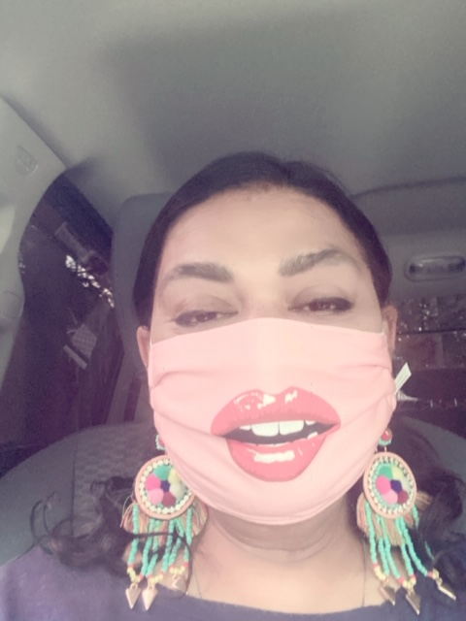
Anita

Slide 77
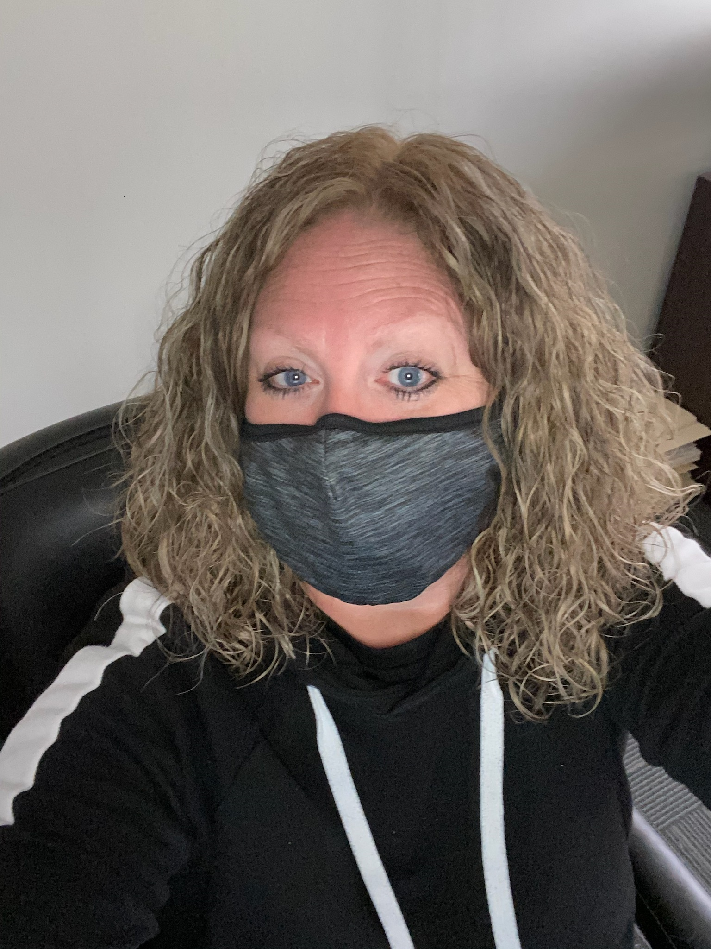
Sarah

Slide 78
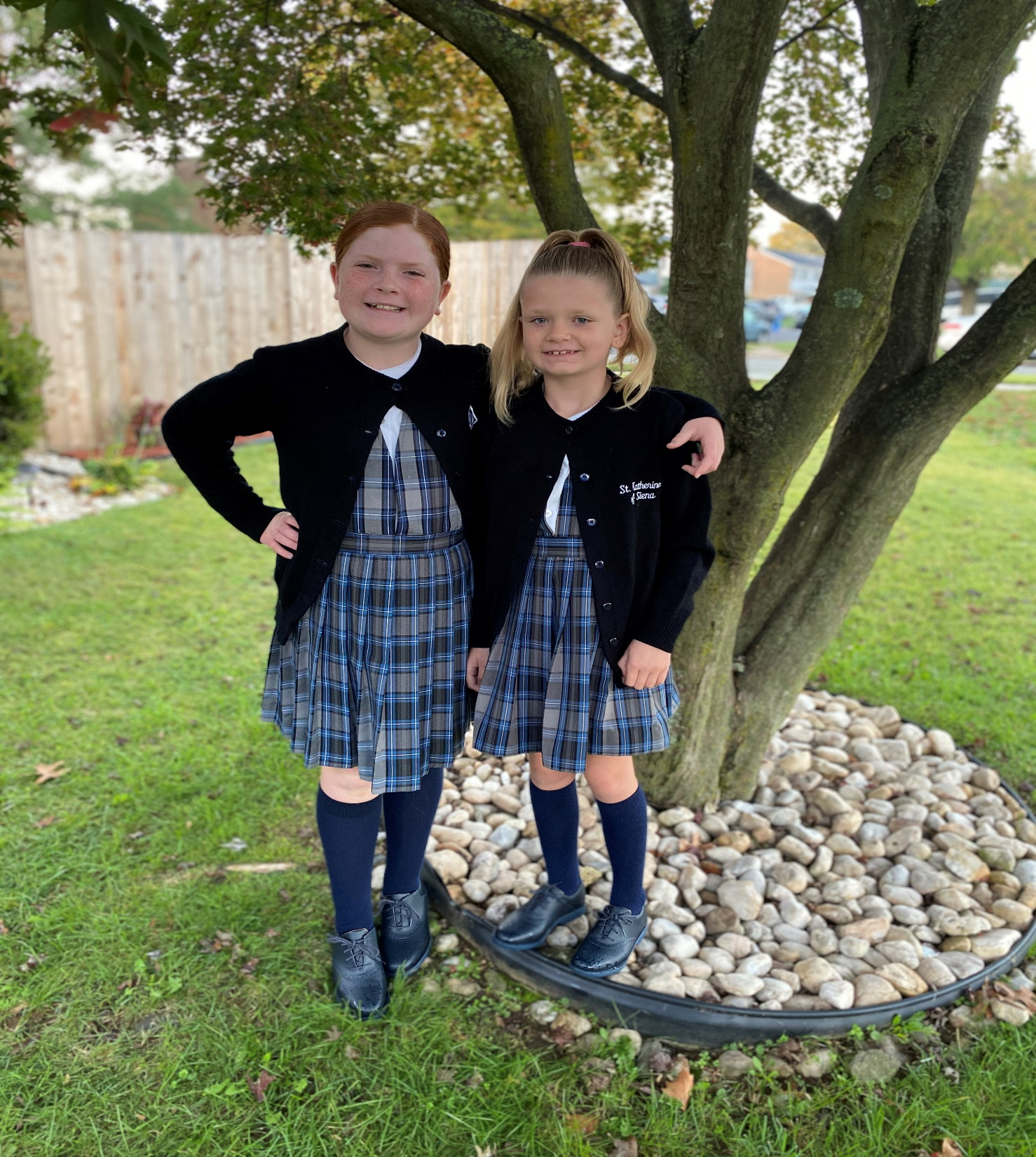
Sarah’s daughters
Lucy and Rosey
First day of school

Slide 79
Lucy’s
First Holy Communion

Slide 80
Genia

Slide 81
Genia’s Grandchildren:
Big Brother Kayden with New baby sister Alori

Slide 83
Dave

Slide 84
Alan

Slide 85
KJ

Slide 86
Hannah Jachowski
Graduated from
OJR High School

Slide 87
And started her freshman year at the University of New Haven

Slide 88
Gabe Jachowski
Became an Essential Worker

Slide 89
Evon

Slide 90
Pat

Slide 91
Lisa

Slide 92
Kathy

Slide 93
Katie Young Arcadia University
December 2020 Graduation

Slide 94
Rob, Kathy, and Katie Young
October 2020
Magic Kingdom

Slide 95
Merry Christmas from the ABCUSA
Virtual Christmas Party Planning Team

