Slide 1

Introducing the Newly Redesigned
CHURCH MISSION SUPPORT
Form

Slide 2
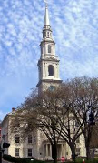
INFORMATION
FOR THE
CHURCHES

Slide 3
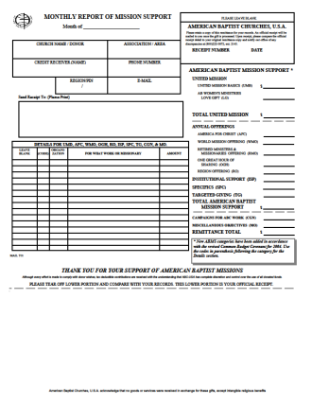
Monthly Report Of Mission Support
The OLD
Format

Slide 4
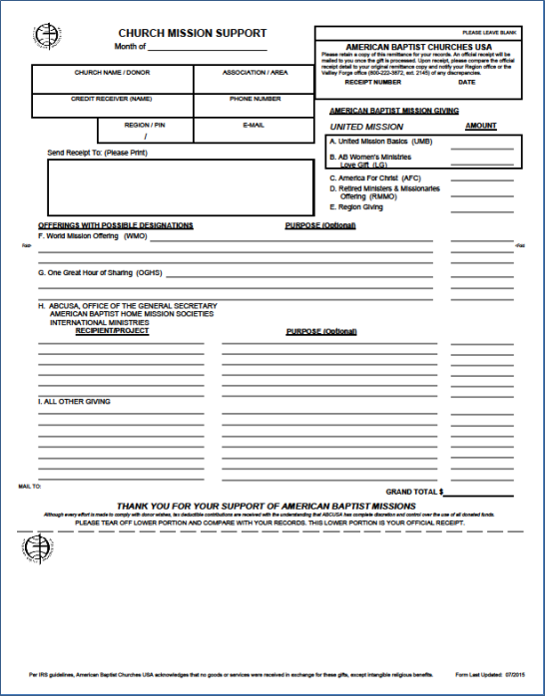
Church Mission Support
The
Format
NEW

Slide 5
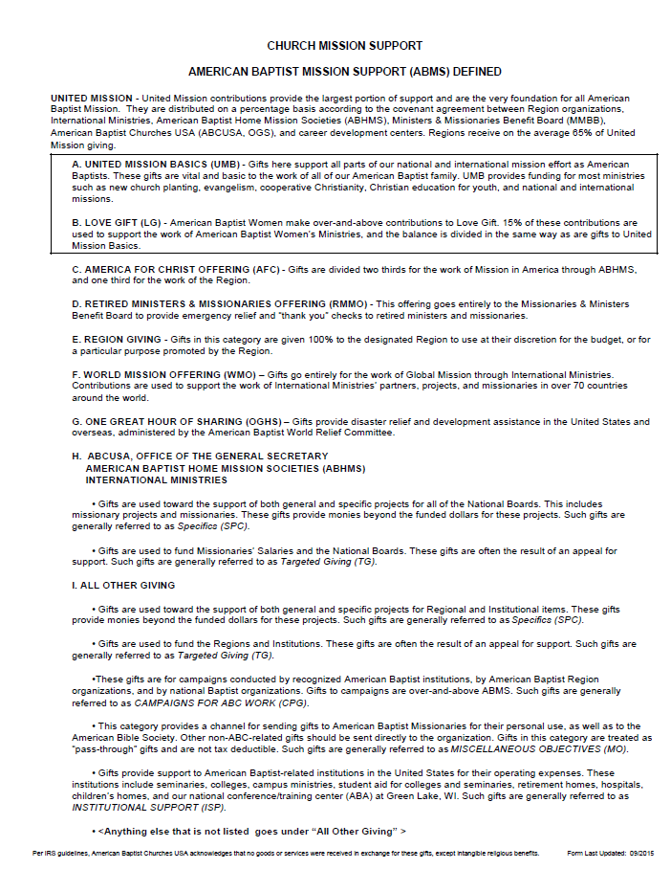
A Total Redesign

Slide 6
The REASON Behind The Redesign
The purpose of redesigning this form is clear and simple: We wanted to make it easier for you, as an ABC church, to submit your mission giving.
To demonstrate how easy it is to use this new form, we will break it down into sections.
We also will include some examples for you to use as guides.

Slide 7
Let’s
take a closer look at the FORM
itself.

Slide 8
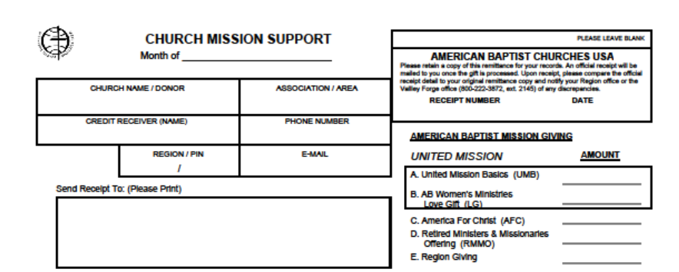
The UPPER Section
The upper section is very much like the original form. Besides the name change, the main difference is that giving categories A – E are grouped together. This is because they require NO additional description or detail – the only thing needed is each gift amount.

Slide 9
The UPPER Section
The upper section is very much like the original form. Besides the name change, the main difference is that giving categories A – E are grouped together. This is because they require NO additional description or detail – the only thing needed is each gift amount.

Slide 10
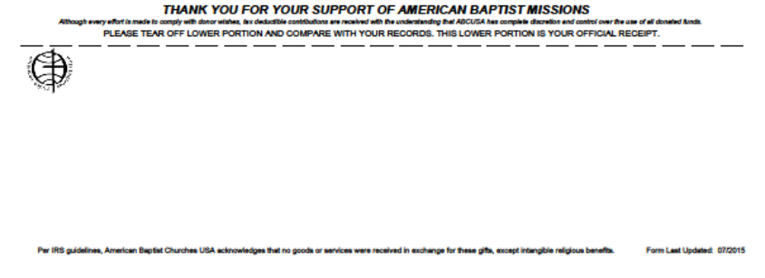
The BOTTOM Section
The bottom receipt section is almost exactly like the original form. The only difference here is that the new version includes the date when the form version was last updated.

Slide 11
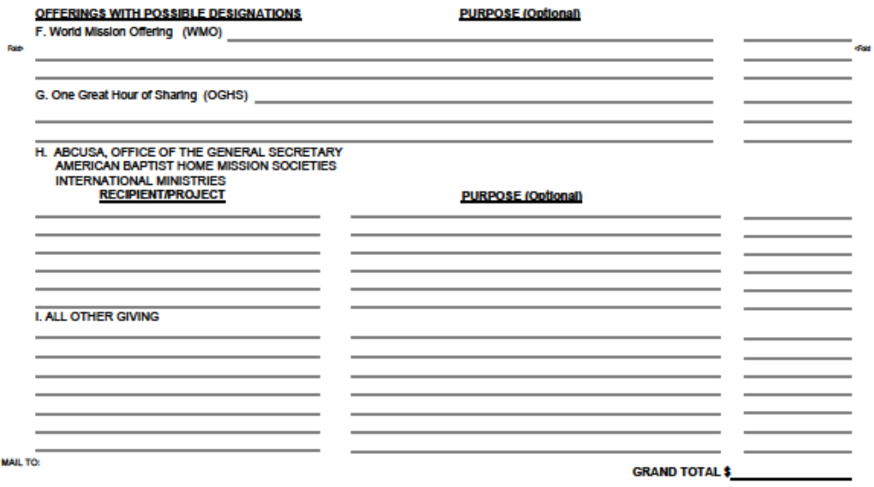
The MIDDLE Section
This is the section of the form that has changed the most. It is divided into giving categories F – I and has columns for you to enter the name/description of each gift, its purpose and its amount.

Slide 12
The MIDDLE Section
This is the section of the form that has changed the most. It is divided into giving categories F – I and has columns for you to enter the name/description of each gift, its purpose and its amount.

Slide 13

Using The Definitions As A Guide
On the Definitions page, there is a complete set of category definitions. These will help you determine which categories to use when posting your gifts.

Slide 14
Let’s see more about this Definitions page.

Slide 15
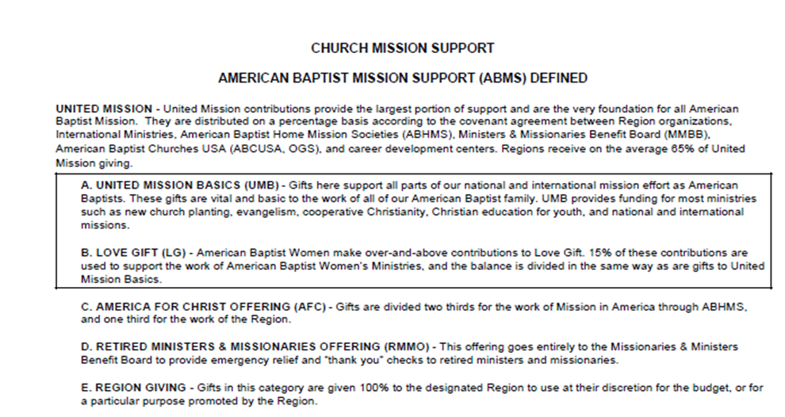
The UPPER Section
The top section defines United Mission (A – B), as well as the giving categories
(C – E). It also explains how your gifts are divided and distributed across the organizations. Again, when posting on the form, these five giving categories require NO additional details.

Slide 16
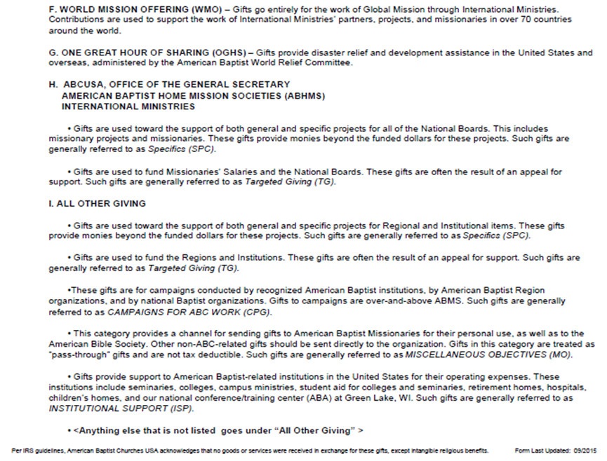
The REMAINDER Of The Page
The remainder of this definitions page defines the remaining giving categories (F – I) in the same way as the top section. Again, when posting on the form, the remaining giving categories DO require additional details.

Slide 17
EXAMPLES
FOR THE
CHURCHES

Slide 18
EXAMPLES
FOR THE
CHURCHES
NOTE
Since the bottom section of the form is actually a receipt stub, we will omit it from the form in the next examples. This will provide each slide with additional room.

Slide 19
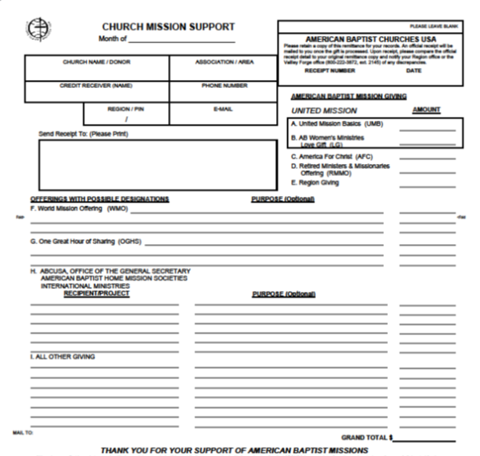
EXAMPLE 1: UNITED MISSION
January 2016
My Baptist Church My Area
My Credit Receiver 999-999-9999
REG 99999 MyArea@gmail.com
My Baptist Church
123 Main St
My Town PA 99999
To post gifts to UNITED MISSION, simply enter amounts into A and/or B.
1,000.00
1,000.00
2,000.00

Slide 20
EXAMPLE 2: THE OFFERINGS
January 2016
My Baptist Church My Area
My Credit Receiver 999-999-9999
REG 99999 MyArea@gmail.com
My Baptist Church
123 Main St
My Town PA 99999
To post gifts to THE OFFERINGS, enter amounts into C, D, E, F and/or G.
It would help to have additional detail when posting to F and/or G.
1,000.00
1,000.00
1,000.00
Wherever it is needed most 1,000.00
Wherever it is needed most 1,000.00
5,000.00

Slide 21
EXAMPLE 3: DISASTER RELIEF
January 2016
My Baptist Church My Area
My Credit Receiver 999-999-9999
REG 99999 MyArea@gmail.com
My Baptist Church
123 Main St
My Town PA 99999
To post gifts to help with DISASTER RELIEF for specific events, enter amounts into G.
Again, it would help to have additional detail.
Hurricane Sandy 1,000.00
Wildfires in Nevada 1,000.00
2,000.00

Slide 22
EXAMPLE 4: MISSIONARY SUPPORT
To post gifts as MISSIONARY SUPPORT, enter amounts into H; but if the missionary support is a part of the WMO, enter the amount into F.
Besides specifying the missionary’s name, please include the purpose, such as salary, the name of a specific project he/she is working on, etc.
January 2016
My Baptist Church My Area
My Credit Receiver 999-999-9999
REG 99999 MyArea@gmail.com
My Baptist Church
123 Main St
My Town PA 99999
Missionary John Doe Salary support 1,000.00
Missionary John Doe Children Ministries Project 1,000.00
Missionary Susie Smith Salary support 1,000.00
3,000.00

Slide 23
EXAMPLE 5: INSTITUTIONAL SUPPORT
January 2016
My Baptist Church My Area
My Credit Receiver 999-999-9999
REG 99999 MyArea@gmail.com
My Baptist Church
123 Main St
My Town PA 99999
To post gifts for INSTITUTIONAL SUPPORT, enter amounts into I.
Again, it would help to have additional detail.
ABC Baptist Camp For Youngsters Roof repair 1,000.00
ABC Baptist Camp For Teens Purchase of sports equipment 1,000.00
2,000.00

Slide 24
EXAMPLE 6: MISCELLANEOUS GIFTS
January 2016
My Baptist Church My Area
My Credit Receiver 999-999-9999
REG 99999 MyArea@gmail.com
My Baptist Church
123 Main St
My Town PA 99999
Not sure where to post your gift? Enter a description in I.
Remember to enter as much detail as you can!
My Baptist Church Food Pantry Kitchen renovation 1,000.00
1,000.00

Slide 25
EXAMPLE 7: COMBINATION ONE
January 2016
My Baptist Church My Area
My Credit Receiver 999-999-9999
REG 99999 MyArea@gmail.com
My Baptist Church
123 Main St
My Town PA 99999
This example combines gifts to United Mission, the Offerings and a missionary.
1,000.00
1,000.00
Hurricane Sandy 1,000.00
Missionary John Doe Children Ministries Project 1,000.00
4,000.00

Slide 26
EXAMPLE 8: COMBINATION TWO
January 2016
My Baptist Church My Area
My Credit Receiver 999-999-9999
REG 99999 MyArea@gmail.com
My Baptist Church
123 Main St
My Town PA 99999
This example combines gifts to United Mission and the Offerings.
1,000.00
1,000.00
1,000.00
1,000.00
Wherever it is needed most 1,000.00
5,000.00

Slide 27
EXAMPLE 9: COMBINATION THREE
January 2016
My Baptist Church My Area
My Credit Receiver 999-999-9999
REG 99999 MyArea@gmail.com
My Baptist Church
123 Main St
My Town PA 99999
This example combines gifts to United Mission, the Offerings and All Other Giving.
1,000.00
1,000.00
1,000.00
ABC Baptist Camp For Teens Purchase of sports equipment 1,000.00
4,000.00

Slide 28
EXAMPLE 10: COMBINATION FOUR
January 2016
My Baptist Church My Area
My Credit Receiver 999-999-9999
REG 99999 MyArea@gmail.com
My Baptist Church
123 Main St
My Town PA 99999
This example combines gifts to United Mission, the Offerings, a missionary and All Other Giving.
1,000.00
1,000.00
Wherever it is needed most 1,000.00
Hurricane Sandy 1,000.00
Missionary Susie Smith Salary support 1,000.00
ABC Baptist Camp For Youngsters Roof repair 1,000.00
My Baptist Church Food Pantry Kitchen renovation 1,000.00
7,000.00

Slide 29
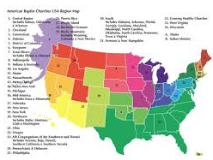
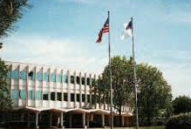
NEED HELP?
Contact:
Your REGION.
ABCUSA at the Mission Center at Valley Forge, PA.

