Slide 1

Introducing the Newly Redesigned
CHURCH MISSION SUPPORT
Form

Slide 2
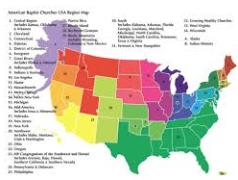
INSTRUCTIONS FOR THE
RECEIVING UNITS

Slide 3
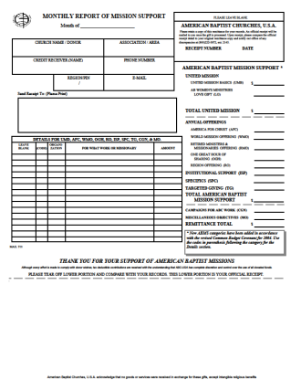
Monthly Report Of Mission Support
The OLD
Format

Slide 4
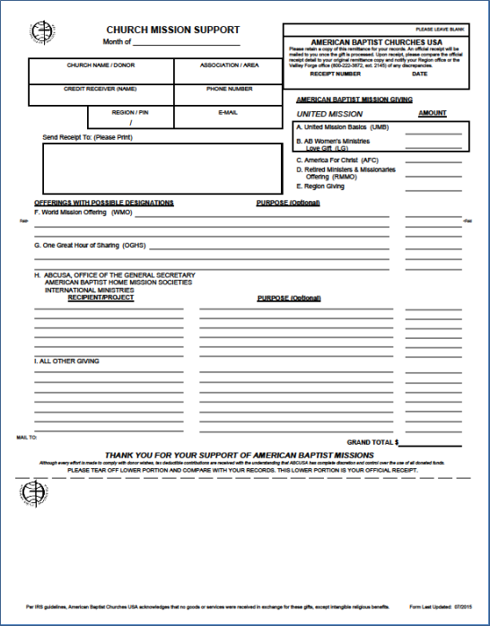
Church Mission Support
The
Format
NEW

Slide 5
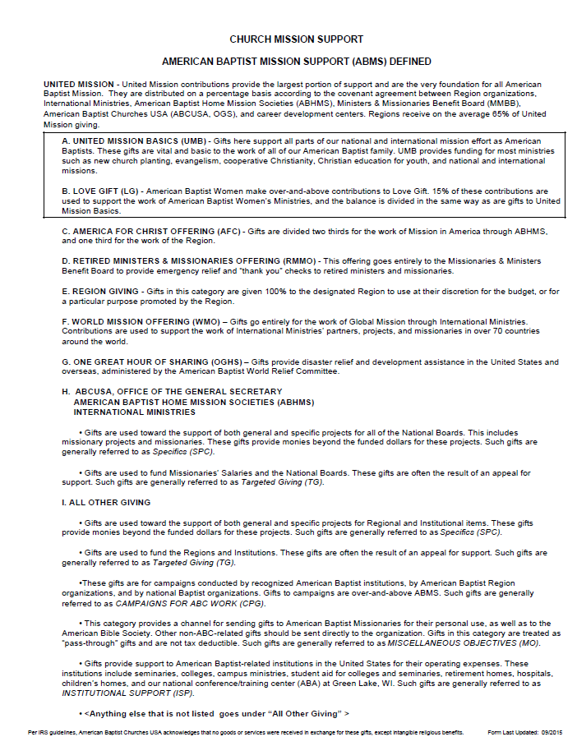
A Total Redesign

Slide 6

The REASON Behind The Redesign
The purpose of redesigning this form is clear and simple: We needed to make it easier for the ABC churches to submit their mission giving.

Slide 7


Now that you understand WHY we reformatted this form, let’s see how it may impact your work as a Receiving Unit…
We’re READY!

Slide 8
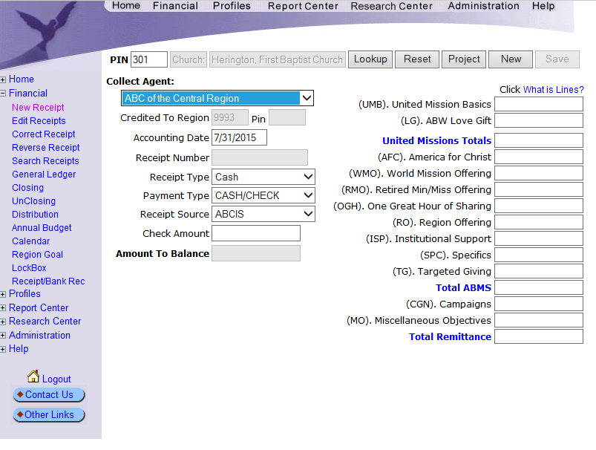
As you know, Receiving Units are responsible to work with the incoming Church Mission Support forms and enter them as new receipts into the American Baptist Churches Information Systems (ABCIS).

Slide 9
The old form had additional columns for the codes, organizations, etc. and a coding section that lined up with the data entry screen.
OLD FORM DATA ENTRY

Slide 10
In order to give more room to the churches, the coding section and additional columns had to be removed.
OLD FORM NEW FORM
X
?
X

Slide 11
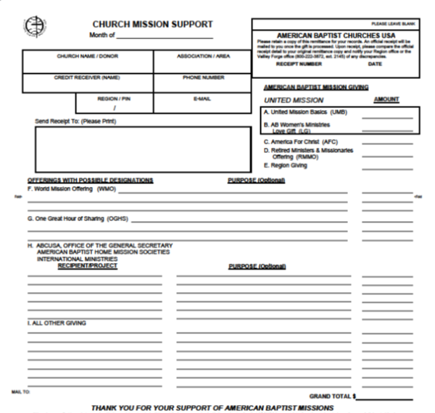
This should not be a problem when:
The church gives just to giving categories A – E;
The other entries are very clearly defined; and
There is space on the form to add any CODES needed.
January 2016
My Baptist Church My Area
My Credit Receiver 999-999-9999
REG 99999 MyArea@gmail.com
My Baptist Church
123 Main St
My Town PA 99999
1,000.00
1,000.00
Missionary John Doe Salary support 1,000.00
3,000.00

Slide 12
January 2016
My Baptist Church My Area
My Credit Receiver 999-999-9999
REG 99999 MyArea@gmail.com
My Baptist Church
123 Main St
My Town PA 99999
In fact, you may want to consider using a different colored pen/pencil when adding your detail.
1,000.00
1,000.00
Missionary John Doe Salary support 1,000.00
DOE13/TG
3,000.00

Slide 13
January 2016
My Baptist Church My Area
My Credit Receiver 999-999-9999
REG 99999 MyArea@gmail.com
My Baptist Church
123 Main St
My Town PA 99999
However, when the form is particularly crowded with detail and/or rather complicated, you might have some difficulty.
1,000.00
1,000.00
1,000.00
Hurricane Sandy 1,000.00
Missionary John Doe Salary support 1,000.00
Missionary Susie Smith 1,000.00
We want $300 to go for salary support, $250 for the Kids Are Special project and
the rest for the God Makes A Difference project.
Missionary John & Mary Jones Salary support 1,000.00
Make sure $500 goes for camperships, $120
for their New Building Fund, $20 for their Bible Team Fund and the rest for the Kids Project or something like that.
ABC Baptist Camp For Teens 1,000.00
ABC Baptist Camp For Youngsters Roof repair 1,000.00
9,000.00

Slide 14
It is for this reason that we have created a WORKSHEET for you.
Using this new tool is completely optional; it is available should you need it.
Let’s See How It Works!

Slide 15
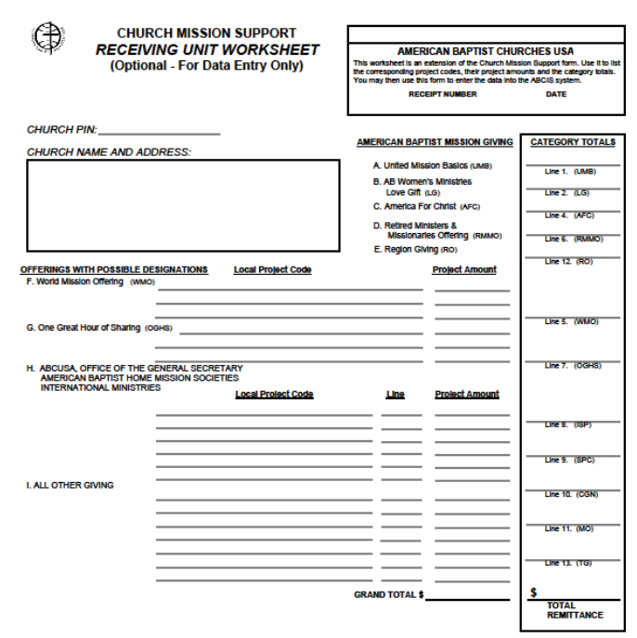
The first thing to notice is that the lines match up with the lines on the new Church Mission Support form.
Also, there are columns for the CODES, LINES and PROJECT AMOUNTS as well as totals for the CATEGORIES.

Slide 16
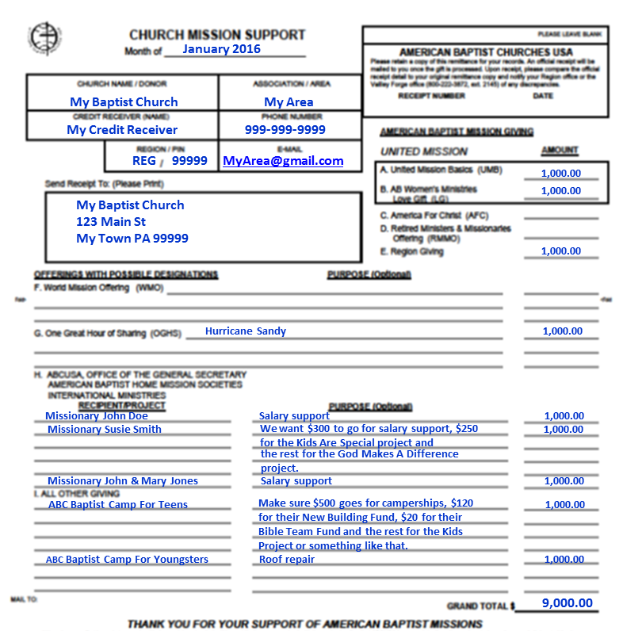
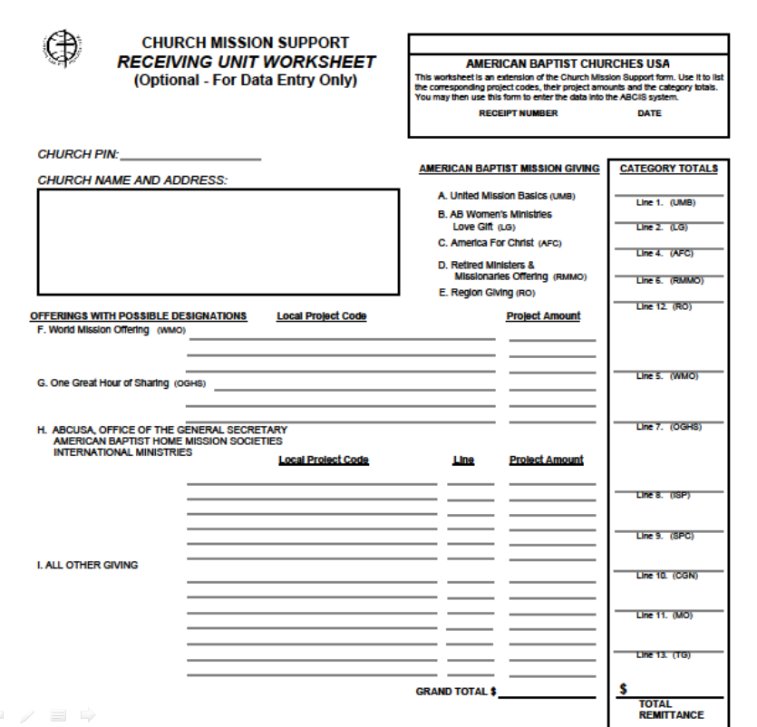
The lines match up...

Slide 17

Let’s enter the CODES for Hurricane Sandy and John Doe…
SANDY 1,000.00
DOE13 TG 1,000.00

Slide 18
Let’s enter the CODES for Susie Smith…
SANDY 1,000.00
DOE13 TG 1,000.00
SMITH13 TG 300.00
KID SPC 250.00
GODDIFF SPC 450.00

Slide 19
Let’s enter the CODES for the John & Mary Jones…
SANDY 1,000.00
DOE13 TG 1,000.00
SMITH13 TG 300.00
KID SPC 250.00
GODDIFF SPC 450.00
JONES13 TG 1,000.00

Slide 20
Let’s enter the CODES for the Camp for Teens…
SANDY 1,000.00
DOE13 TG 1,000.00
SMITH13 TG 300.00
KID SPC 250.00
GODDIFF SPC 450.00
JONES13 TG 1,000.00
TEENSCAMP SPC 500.00
TEENSBLDG CPG 120.00
TEENSBIBLE SPC 20.00
KIDS SPC 360.00

Slide 21
Let’s enter the CODES for the Camp for Youngsters…
SANDY 1,000.00
DOE13 TG 1,000.00
SMITH13 TG 300.00
KID SPC 250.00
GODDIFF SPC 450.00
JONES13 TG 1,000.00
TEENSCAMP SPC 500.00
TEENSBLDG CPG 120.00
TEENSBIBLE SPC 20.00
KIDS SPC 360.00
YOUNGSTERS SPC 1,000.00

Slide 22
Let’s add up and enter the CATEGORY TOTALS…
1,000.00
1,000.00
1,000.00
1,000.00
2,580.00
120.00
2,300.00
9,000.00
SANDY 1,000.00
DOE13 TG 1,000.00
SMITH13 TG 300.00
KID SPC 250.00
GODDIFF SPC 450.00
JONES13 TG 1,000.00
TEENSCAMP SPC 500.00
TEENSBLDG CPG 120.00
TEENSBIBLE SPC 20.00
KIDS SPC 360.00
YOUNGSTERS SPC 1,000.00

Slide 23
Now you are ready to enter the receipt detail into ABCIS!
1,000.00
1,000.00
1,000.00
1,000.00
2,580.00
120.00
2,300.00
9,000.00
SANDY 1,000.00
DOE13 TG 1,000.00
SMITH13 TG 300.00
KID SPC 250.00
GODDIFF SPC 450.00
JONES13 TG 1,000.00
TEENSCAMP SPC 500.00
TEENSBLDG CPG 120.00
TEENSBIBLE SPC 20.00
KIDS SPC 360.00
YOUNGSTERS SPC 1,000.00

Slide 24
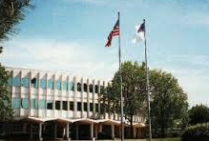
NEED ADDITIONAL HELP?
Contact ABCUSA at the Mission Center at Valley Forge:
800-222-3872, Ext. 2145.

